Slide 1
Yandex / NLP / MT
2019-03-20
DeepNLP
현청천

Slide 2
Neural Machine Translation

Slide 3
Problems with Phrase-based MT
Unrealistic independence assumptions
Curse of dimensionality
Impossible to optimize end-to-end
Reliance on hand-crafted language specific features
http://www.statmt.org/book/slides/05-phrase-based-models.pdf
Notes:
비현실적인 독립 가정
차원의 저주
최적화 불가
사람이 작성한 언어 특징에 대한 신뢰

Slide 4
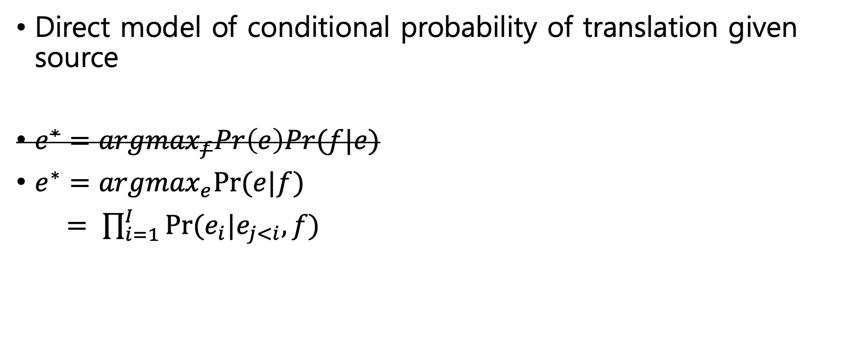
Neural Machine Translation
Direct model of conditional probability of translation given source
$e^{∗}={argmax}_{f}Pr\left(e\right)Pr(f|e)$
$e^{∗}={argmax}_{e}Pr(e|f)$
$= \prod_{i=1}^{I}{Pr⁡(e_{i}|e_{j<i},f)}$
Notes:
Phrase-based MT의 수식을 대체 함

Slide 5
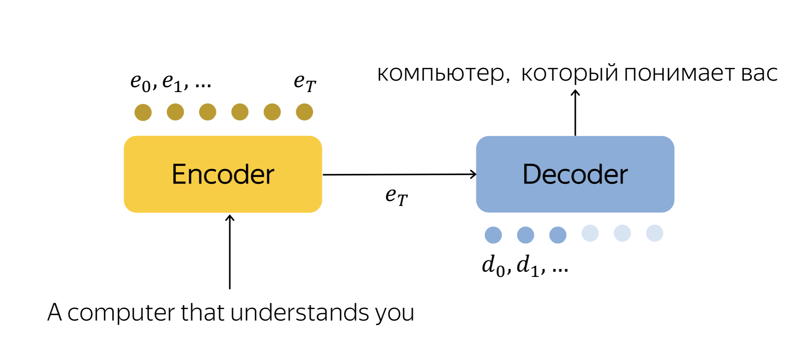
Neural Machine Translation
Notes:
Sequence to sequence model

Slide 6
Encoder Decoder
No explicit independence assumptions
Learned representations(word embeddings)
End-to-end optimization
Notes:
독립 가정 없음
학습된 표현 사용 (Word embedding)
최적화 가능

Slide 7
Problems with Vanilla Encoder Decoder
Poor performance on long sentences
Bias towards shorter candidates(?)
Fluent but inadequate output
No guarantee that all input words are translated
Notes:
긴 문장에 대한 낮은 성능
짧은 문장을 출력하는 경향
그럴 듯 하지만 부정확한 출력
모든 입력 단어가 번역 되지 않을 수 있음

Slide 8
Attention
Allow model to scale with sentence length
Allow model to focus on specific information during translation
Not quite word alignments
https://hulk89.github.io/neural%20machine%20translation/2017/04/04/attention-mechanism/
Notes:
모델이 문장의 길이에 따라 크기가 변한다 ??
모델이 특정한 정보에 집중 하도록 한다.
Word alignments에 전적으로 의존 하지 않는 다

Slide 9
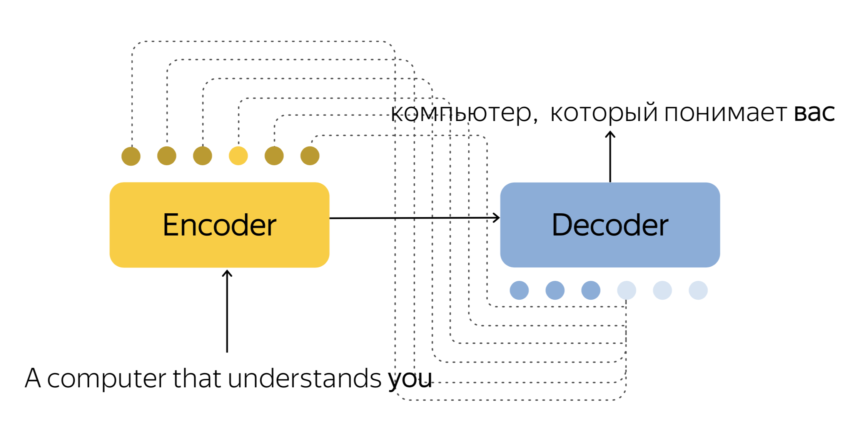
Neural Machine Translation

Slide 10
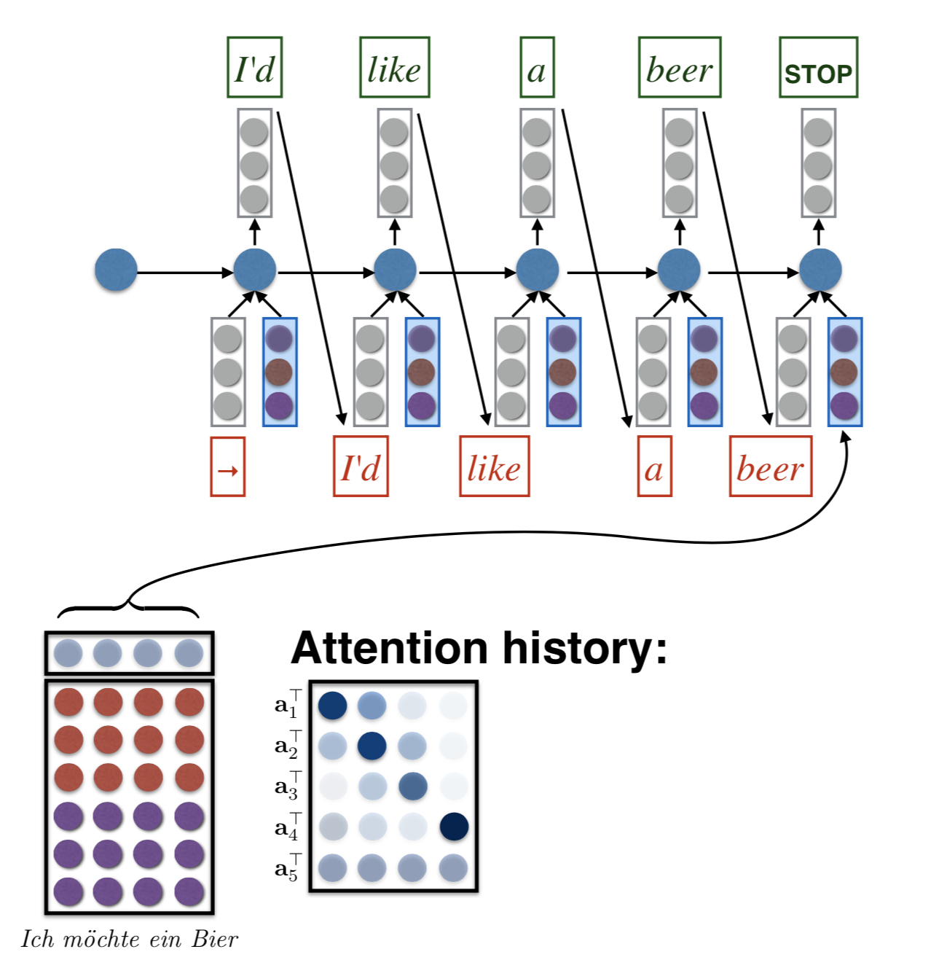
Decode with Attention

Slide 11
Encoder-Decoder With Attention
Removes bottleneck of vanilla Encoder-Decoder
Weakens correlation between sentence length and quality
Improves adequacy (but not completely)
Encoder-decoder with attention became SOTA in 2015
Notes:
바닐라 RNN의 병목 현상을 제거
문장 길이와 품질 사이의 약한 상관 관계
문장의 정확도 향상
2015년 SOTA

Slide 12
Application Specific Features
Length normalization
Coverage penalty

Slide 13
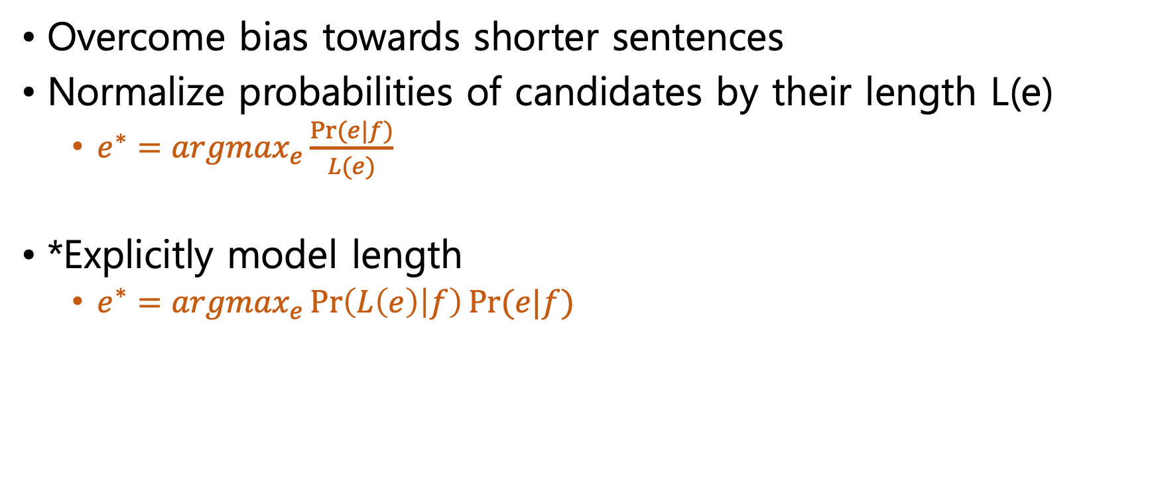
Length Normalization
Overcome bias towards shorter sentences
Normalize probabilities of candidates by their length L(e)
$e^{∗}={argmax}_{e}\frac{Pr⁡(e|f)}{L(e)}$
*Explicitly model length
$e^{∗}={argmax}_{e}\operatorname{Pr}\left(L\left(e\right) | f\right)Pr⁡(e|f)$
Notes:
짧은 문장으로 번역하려는 경향을 극복하기 위함
문장의 길이로 normalize 한다.
명시적인 모델 길이

Slide 14
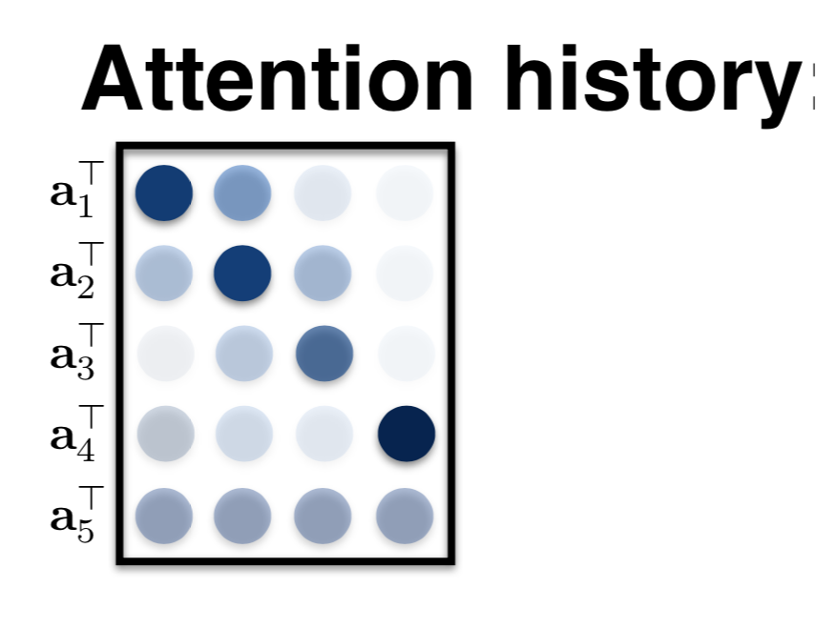
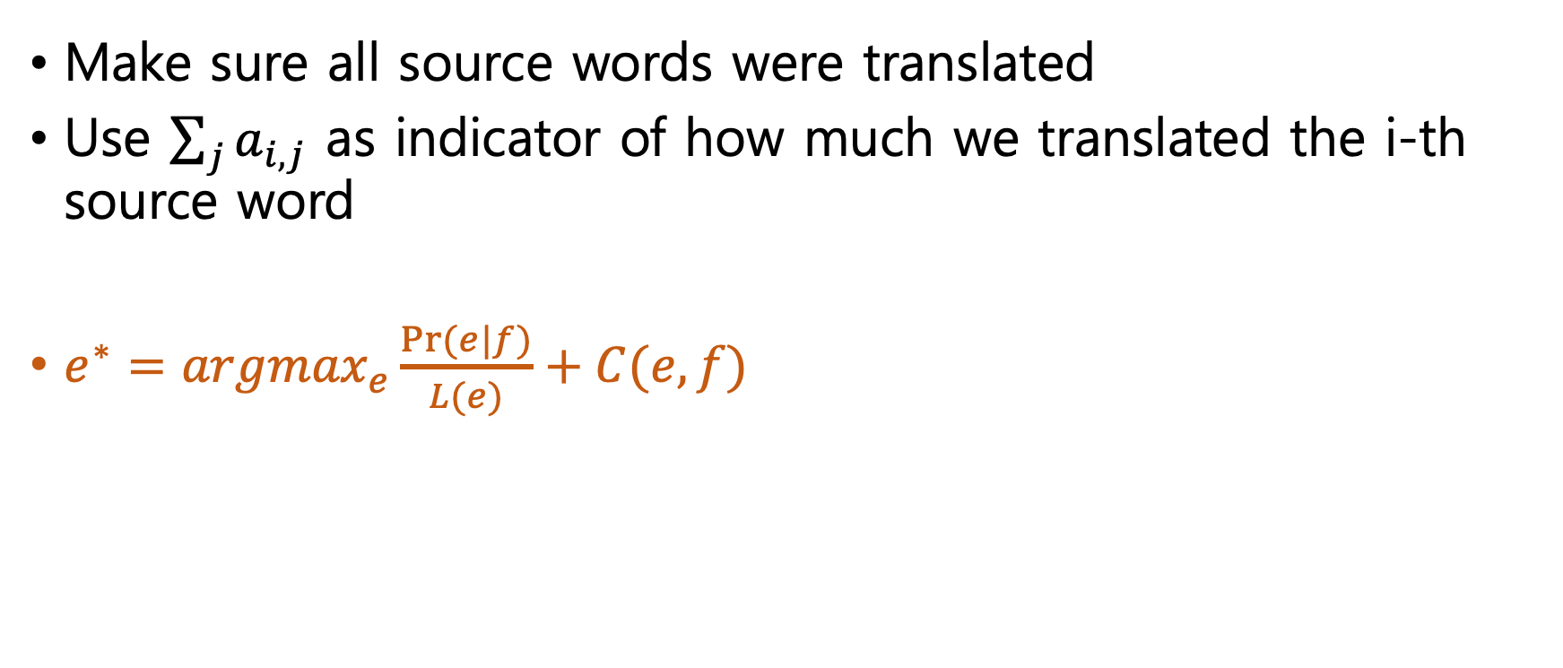
Coverage Penalty
Make sure all source words were translated
Use $\sum_{j}{a_{i,j}}$ as indicator of how much we translated the i-th source word
$e^{∗}={argmax}_{e}\frac{Pr⁡(e|f)}{L(e)}+C(e,f)$
Notes:
모든 문장이 번역된다.
I번째 단어가 어떤 가중치로 활용 되는지 확인 가능

Slide 15
What are the main computational and statistical bottlenecks in NMT?

Slide 16
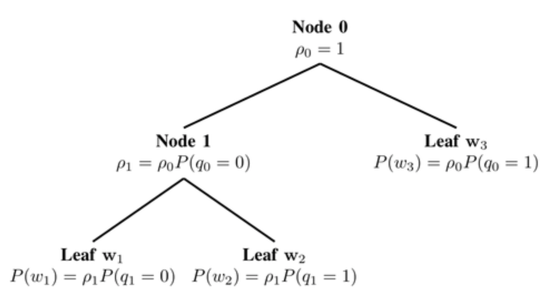
Computation Bottlenecks in NMT
SoftMax dominates most architectures
Naively O(vocab)
Hierarchical O(log(vocab))
https://dalpo0814.tistory.com/7
Notes:
Softmax는 대부분의 구조에서 압도적으로 사용됨
훈련이 부족한
계층적 (softmax)

Slide 17
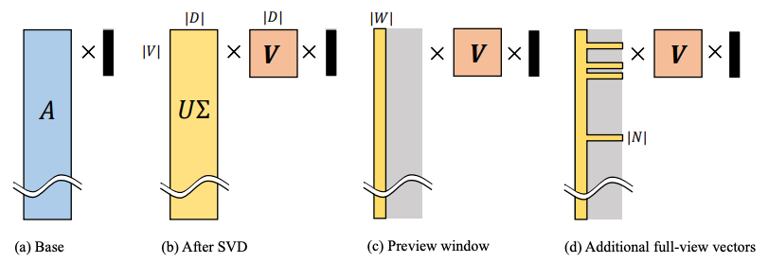
Computation Bottlenecks in NMT
SVD SoftMax
Importance sampling
Vocabulary selection
https://darkpgmr.tistory.com/106
https://untitledtblog.tistory.com/135
https://papers.nips.cc/paper/7130-svd-softmax-fast-softmax-approximation-on-large-vocabulary-neural-networks.pdf
Notes:
특이값 분해
중요도 셈플링
중요 단어 선택

Slide 18
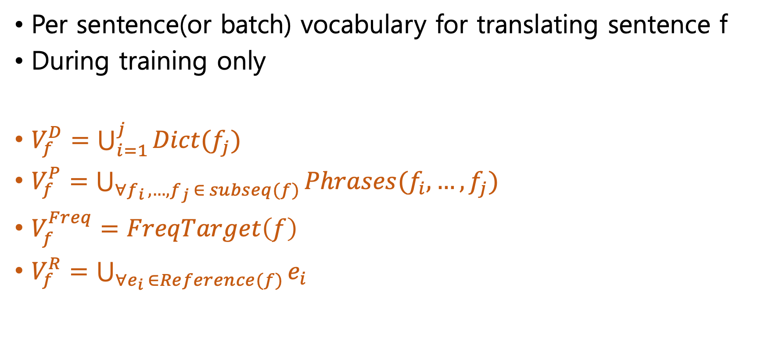
Vocabulary Manipulation
Per sentence(or batch) vocabulary for translating sentence f
During training only
$V_{f}^{D}=\bigcup_{i=1}^{j}{Dict(f_{j})}$
$V_{f}^{P}=\bigcup_{∀f_{i },…,f_{j} ∈ subseq(f)}{Phrases(f_{i},…,f_{j})}$
$V_{f}^{Freq}=FreqTarget\left(f\right)$
$V_{f}^{R}=\bigcup_{∀e_{i} ∈Reference(f)}{e_{i}}$
Notes:
단어처리
1. 번역 문장 f에 대한 단어
2. 학습 시에만 사용

Slide 19
Statistical Bottlenecks in NMT
Number of parameters dominated by size of word embeddings
Unknown word rate depends on vocab size
UNK replacement(using alignments)
Byte-pair encoding
Character-based models smaller but slower
https://en.wikipedia.org/wiki/Byte_pair_encoding
Notes:
embedding size가 다른 파라미터 보다 중요하다.
Vocab 크기에 따라 unknown word 비율이 달라짐

Slide 20
What are the pros/cons of different Encoder-Decoder architectures?
Notes:
찬성/반대 – 장단점.

Slide 21
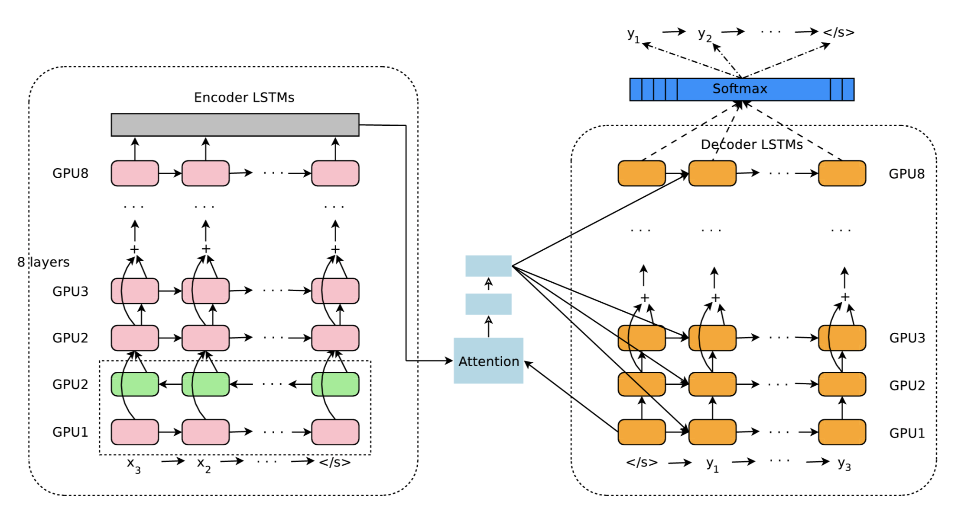
Deep Encoder-Decoder Models(GNMT)
https://norman3.github.io/papers/docs/google_neural_machine_translation.html
https://lovit.github.io/nlp/2018/04/02/wpm/

Slide 22
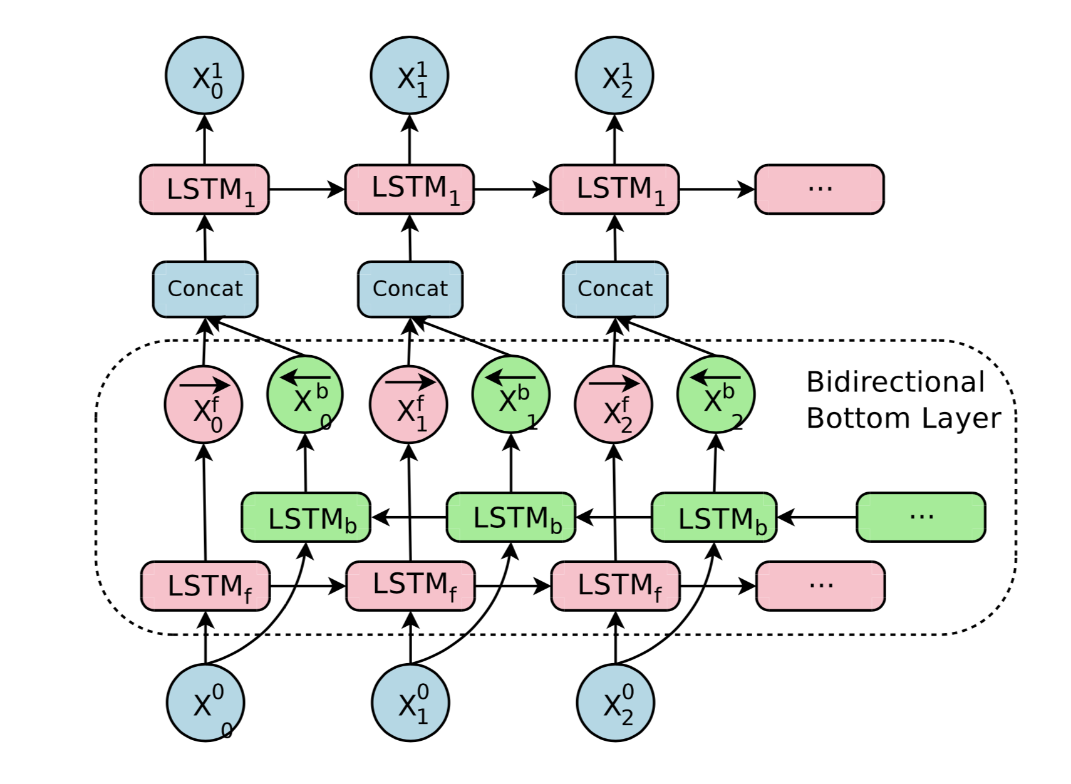
Deep Encoder-Decoder Models(GNMT)

Slide 23
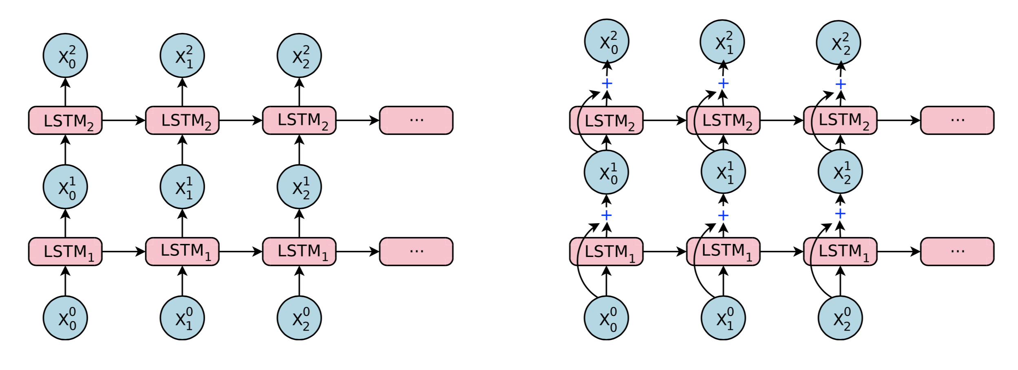
Deep Encoder-Decoder Models(GNMT)
Notes:
Residual connection

Slide 24
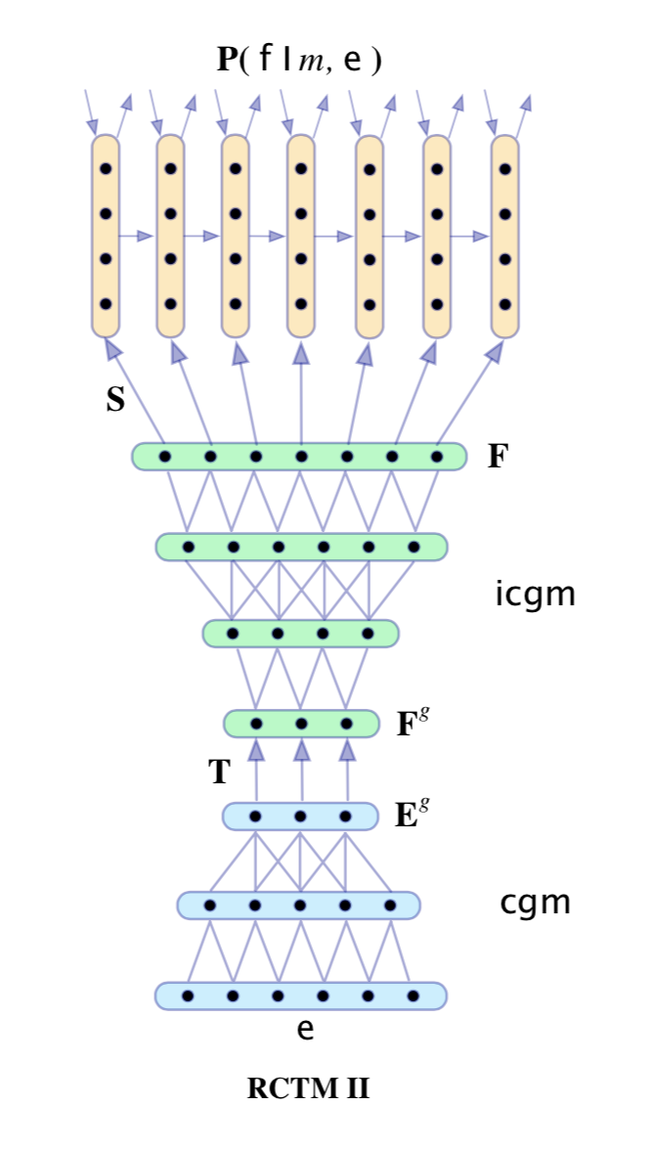
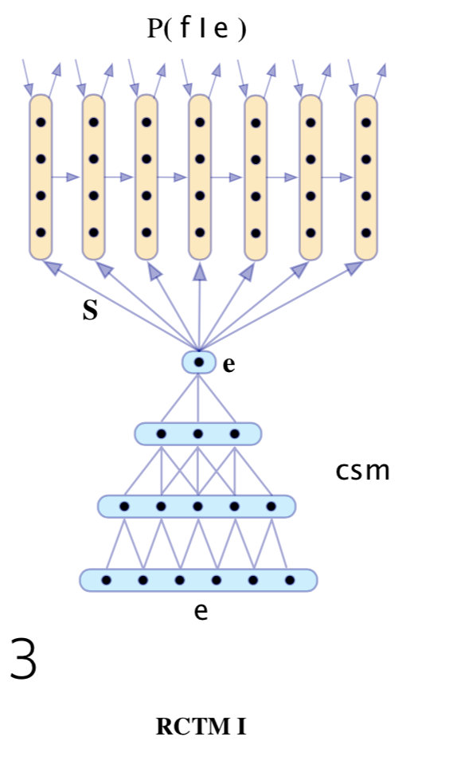
Convolutional Sequence-to-Sequence Models
Convolutions can be parallelized easily (unlike RNNs)
Can be stacked to model more dependencies
Naturally build hierarchical representations
https://norman3.github.io/papers/docs/fairseq.html
https://reniew.github.io/44/
Notes:
1. CNN 은 동시 실행이 가능 하다.
2. 더 많은 의존성을 모델링하기 위해 스택 될 수 있음
3. 계층 적 표현을 자연스럽게 구축

Slide 25
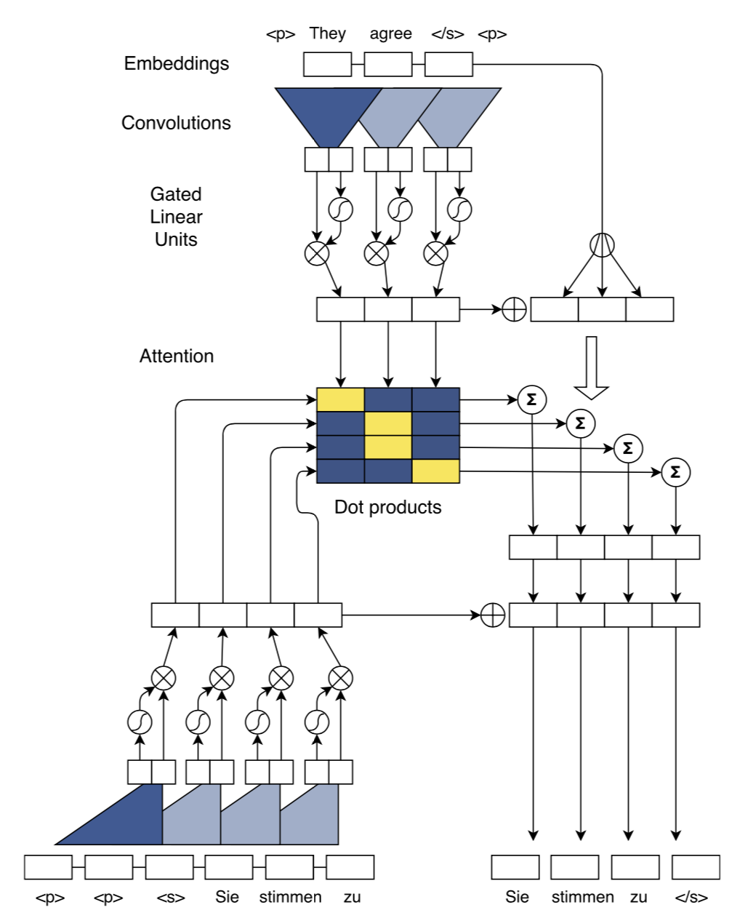
Convolutional Sequence-to-Sequence Models
Add positional embeddings to inputs
Input field limited by kernel width k and number of layers n
Residual connections between layers
Careful normalization(uniform variance) weight-normalization ??
Multi-attention(computed in each layer)
Source embeddings provided to attention
Decoder has access to attention history

Slide 26

Transformer
Lots going on in the paper
Use feed-forward network for sequence-to-sequence task
Self-attention
Multi-head attention
Label smoothing
Layer normalization
…
Label smoothing: Target 값을 one-hot encoding을 사용하는 것이 아니라,
값이 0 인 레이블에 대해서도 아주 작은 값 ee 를 배분하고 정답은 대충 1−(n−1)∗e1−(n−1)∗e 로 값을 반영하는 것이다.
https://kakalabblog.wordpress.com/2017/07/27/gan-tutorial-2016/

Slide 27
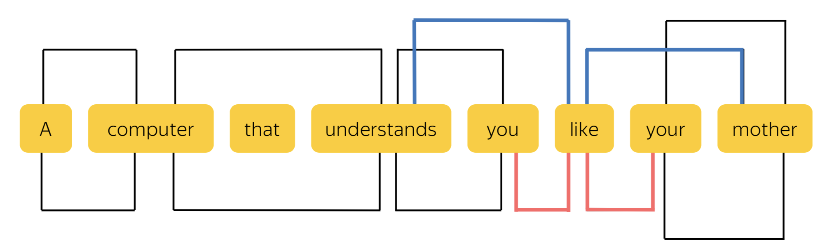
Self Attention

Slide 28
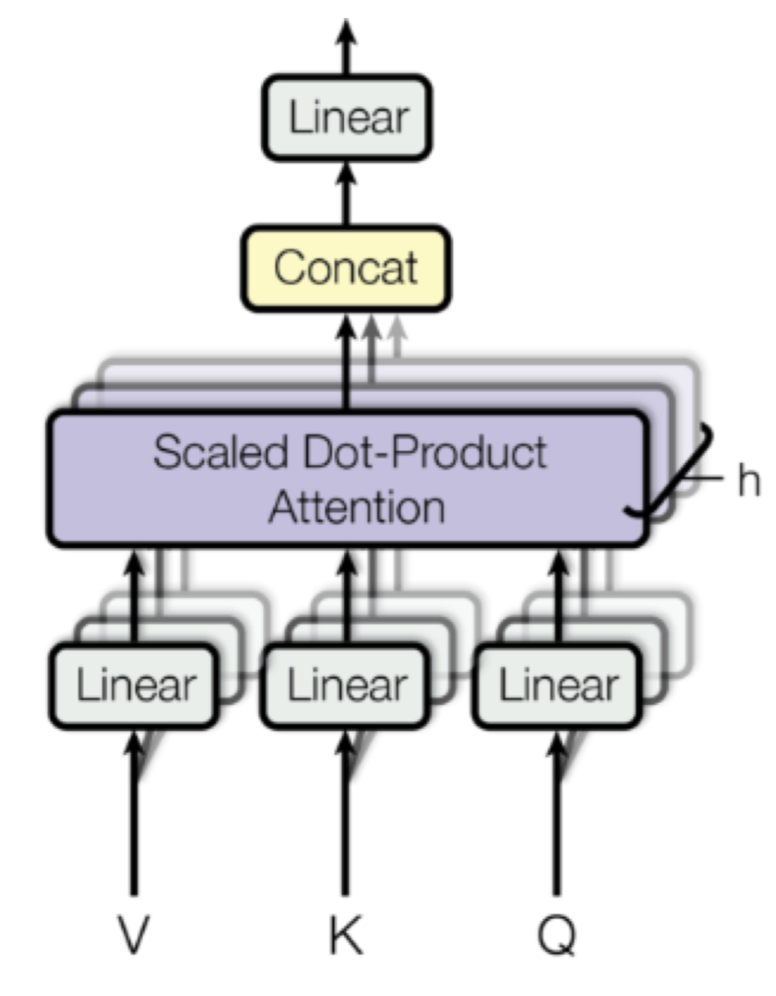
Multi-Head Attention
Она руководит новым проектом
Gender agreement
Case government
Lexical preferences

Slide 29
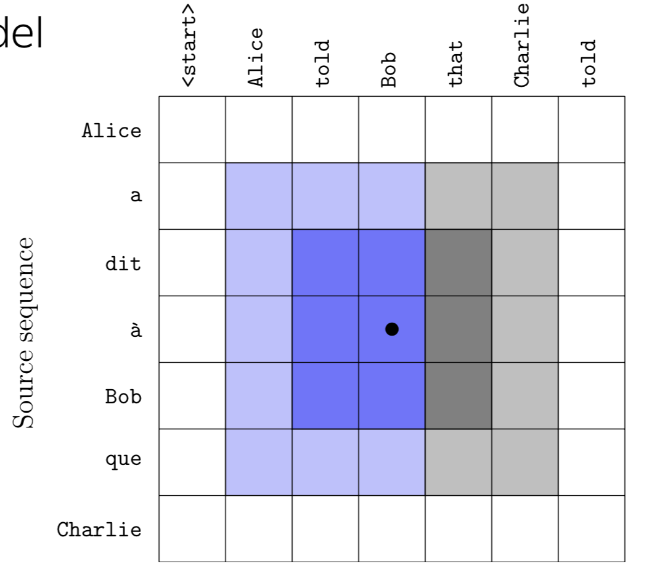
Pervasive Attention
2D convolutional sequence to sequence model
Recomputes source sentence encoding based on target words generated so far
Combined max pooling with self-attention
Seems to work well on short sequences maybe not so well on longer ones
https://arxiv.org/pdf/1808.03867.pdf
https://www.facebook.com/groups/TensorFlowKR/permalink/746291459045248/

Slide 30
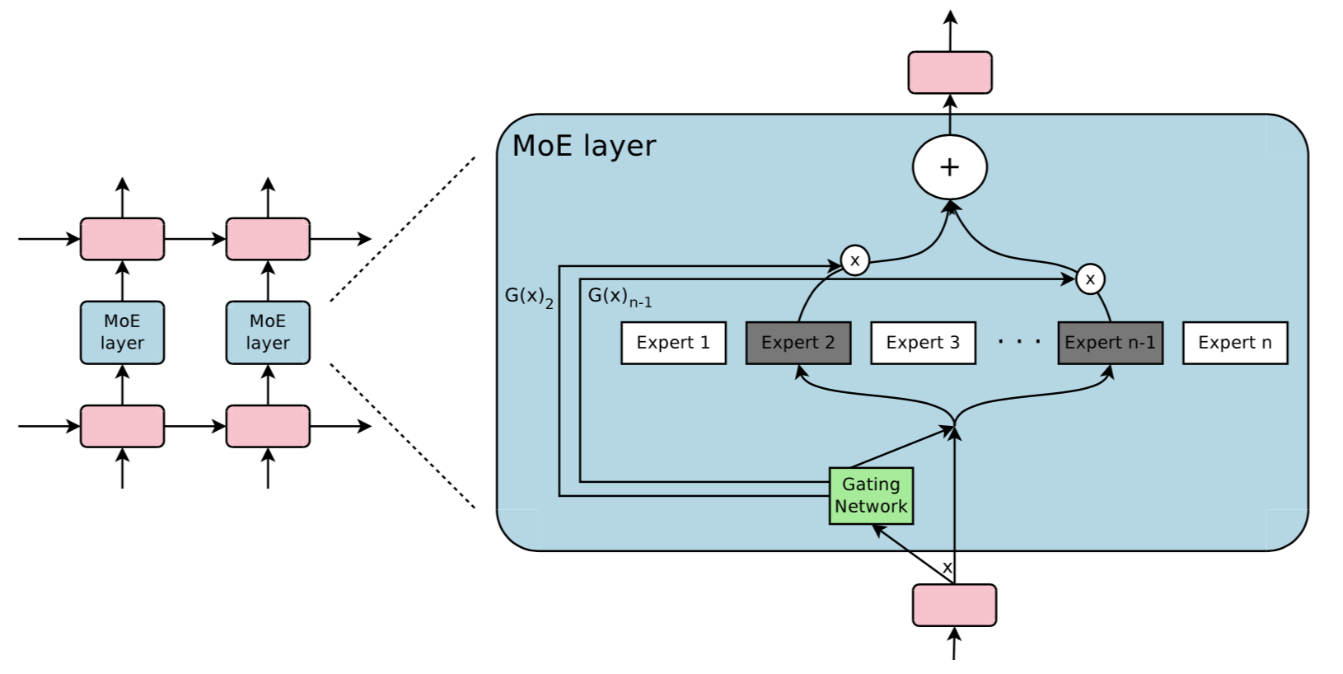
Mixtures of Experts
Conditional computation to increase model capacity efficiently
Noisy top-K gate: Sparse mixture of models (experts)
Requires both data and model parallelism to work
https://people.cs.pitt.edu/~milos/courses/cs2750-Spring04/lectures/class22.pdf

Slide 31
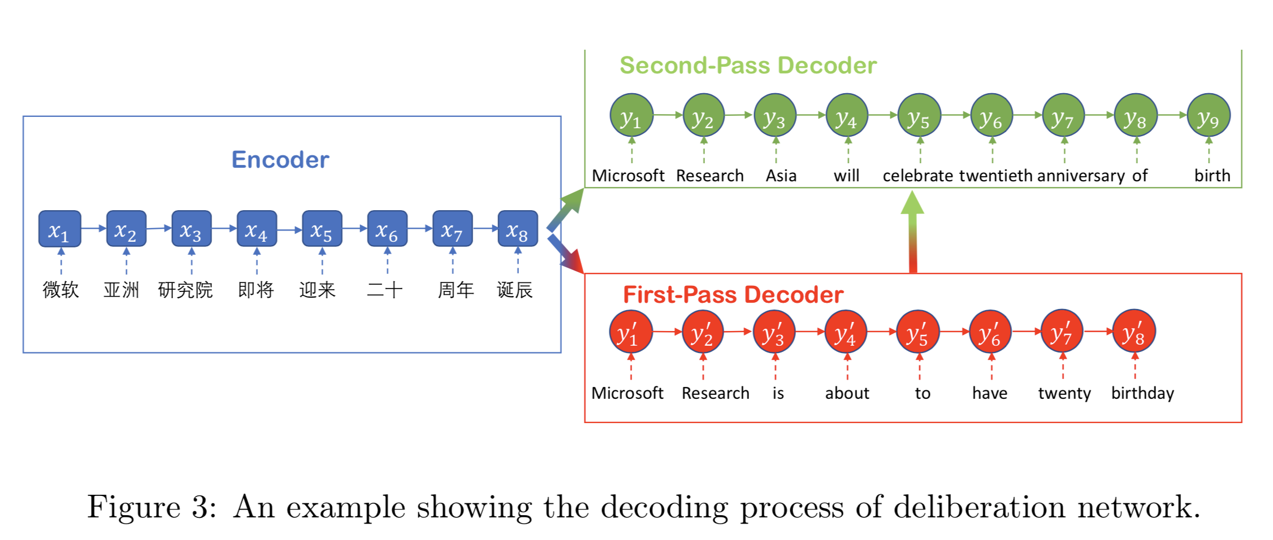
Deliberation Networks
https://www.microsoft.com/en-us/research/blog/deliberation-networks/

Slide 32
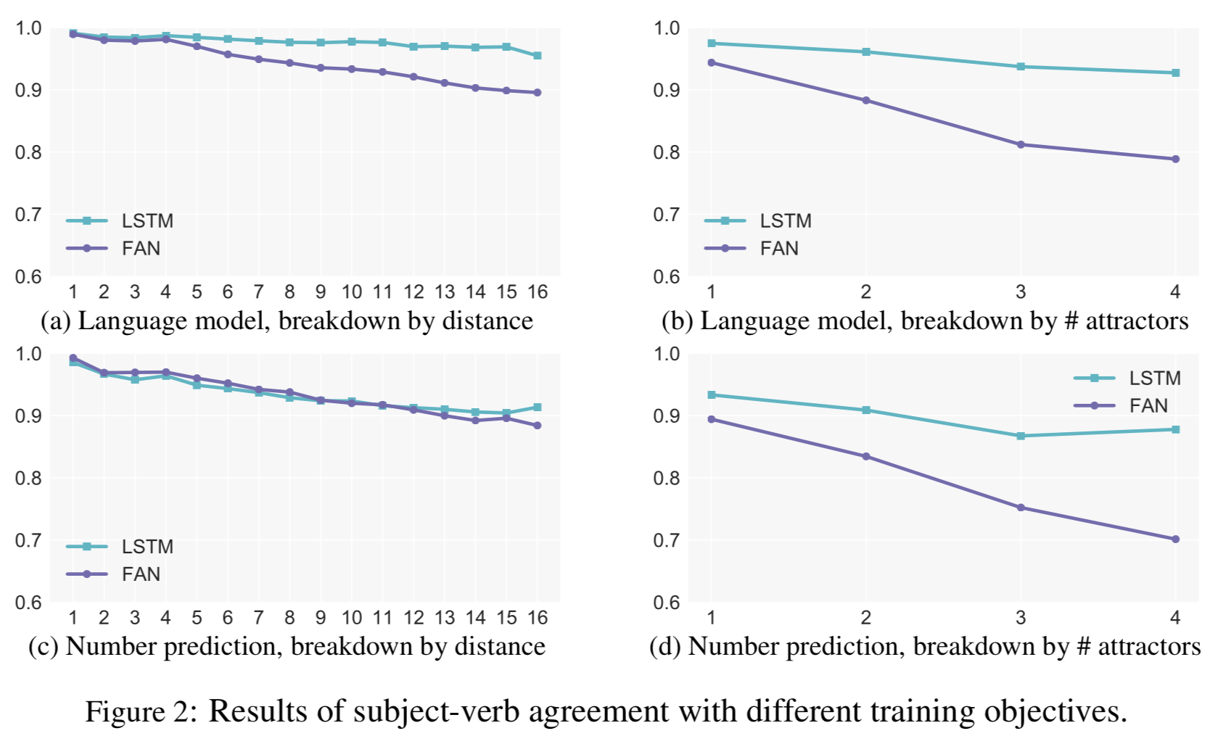
Are RNNs Necessary?
Language is hierarchical (i.e. it allows embedding)
Subject-verb agreement
https://arxiv.org/pdf/1803.03585.pdf
https://webapps.towson.edu/ows/sub-verb.htm
Notes:
Fully Attentional Network (FAN)

Slide 33
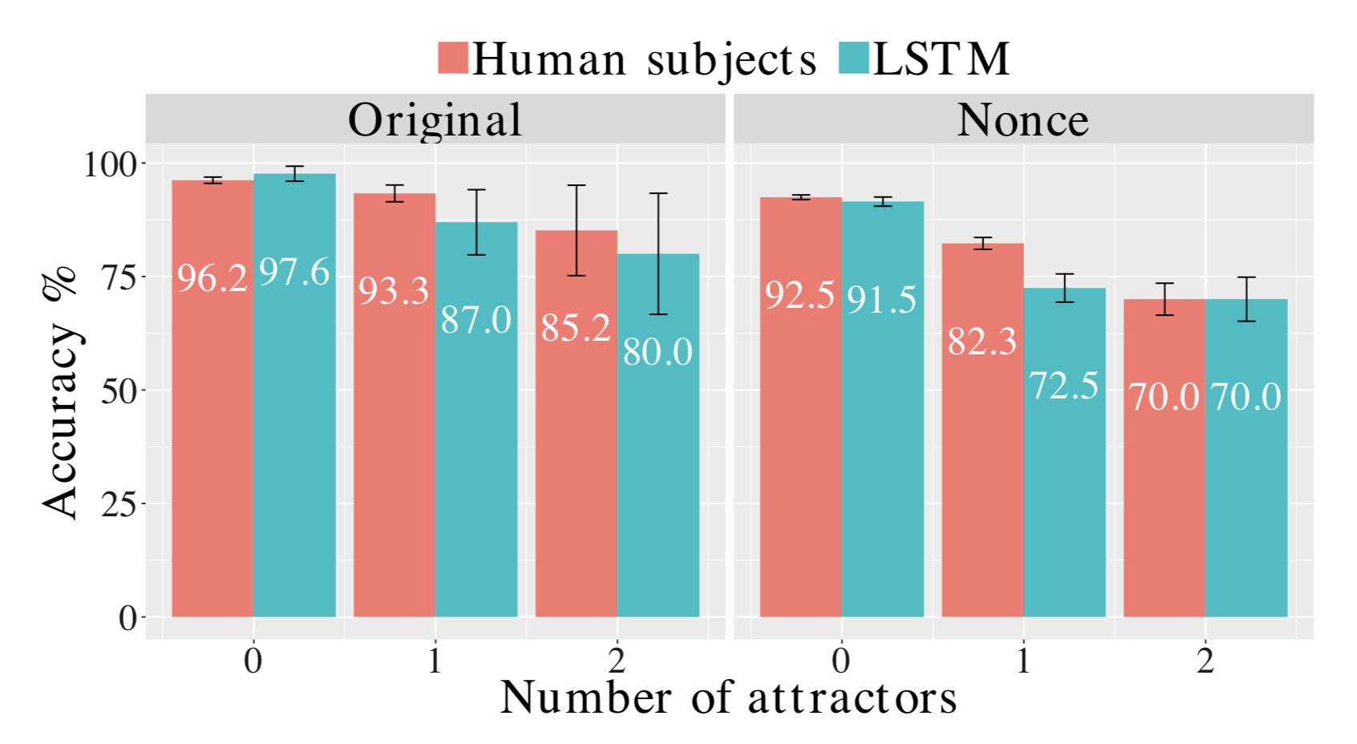
Are RNNs Necessary?
As good as humans on non-sensical data :)
Notes:
non-sensical: 터무니 없는

Slide 34
Maximum Path Length
Architecture | Complexity per layer | Sequential operations | Maximum path length
Self-Attention | O( n^2 d ) | O(1) | O(1)
Recurrent | O(n d^2 ) | O(n) | O(n)
Convolutional | O(kn d^2 ) | O(1) | O(log_k(n))

Slide 35
How can monolingual data be used to improve NMT?

Slide 36
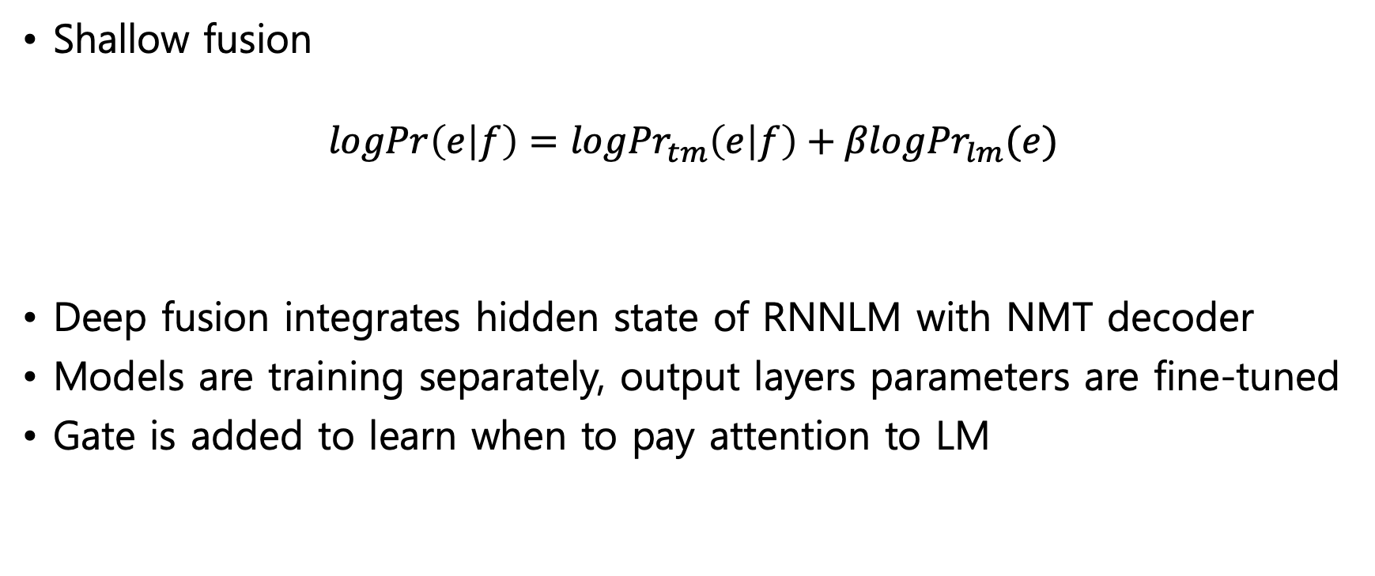
Language Models
Shallow fusion
$$logPr\left(e | f\right)=log{Pr}_{tm}\left(e | f\right)+βlog{Pr}_{lm}(e)$$
Deep fusion integrates hidden state of RNNLM with NMT decoder
Models are training separately, output layers parameters are fine-tuned
Gate is added to learn when to pay attention to LM
https://arxiv.org/pdf/1503.03535.pdf
Notes:
하나의 토큰을 번역할때 후보 문자를 참조해서 예측 하냐가 shallow , hidden layer 쪽에 바로 바로 집어넣으면서 예측하는걸 deep이라고 하는거 같은데요

Slide 37
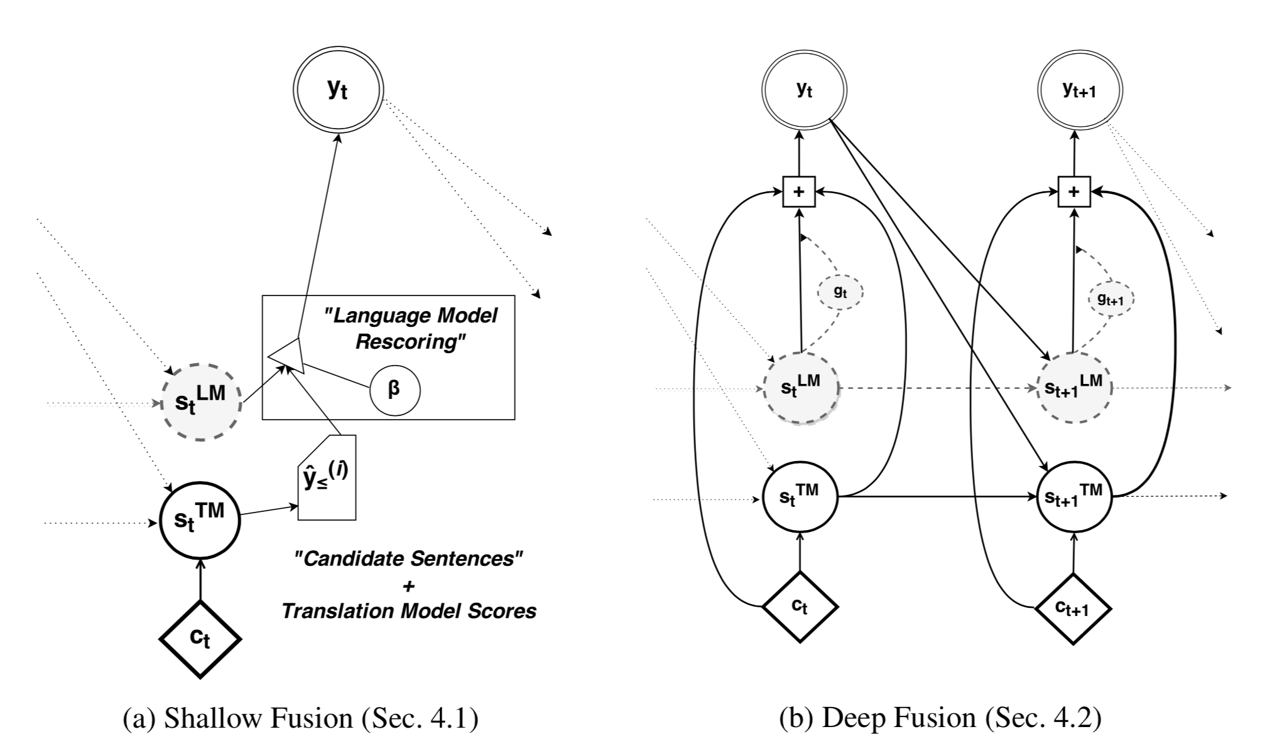
Language Models

Slide 38
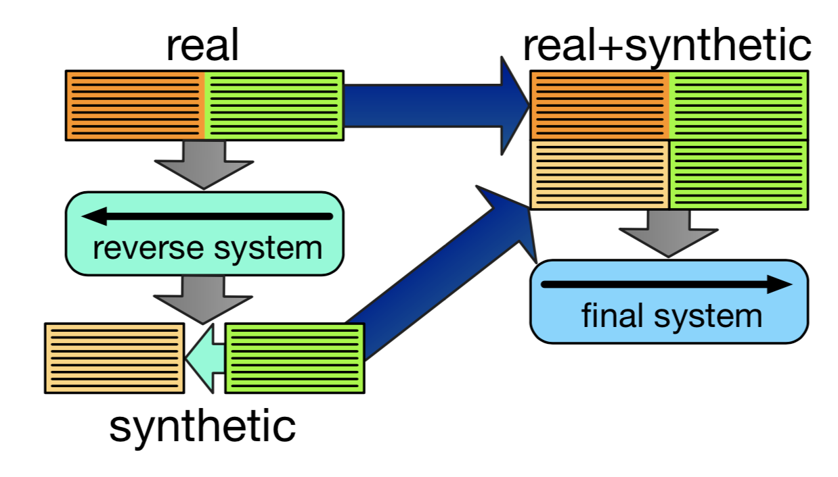
Back-translation
Build a corpus by translating from target to source
Why does it work better than self-training?
Is it just domain adaptation?
Quality of back-translation model matters
Ratio of 1:3 real to synthetic data
알 수 없음
http://www.aclweb.org/anthology/W18-2703

Slide 39
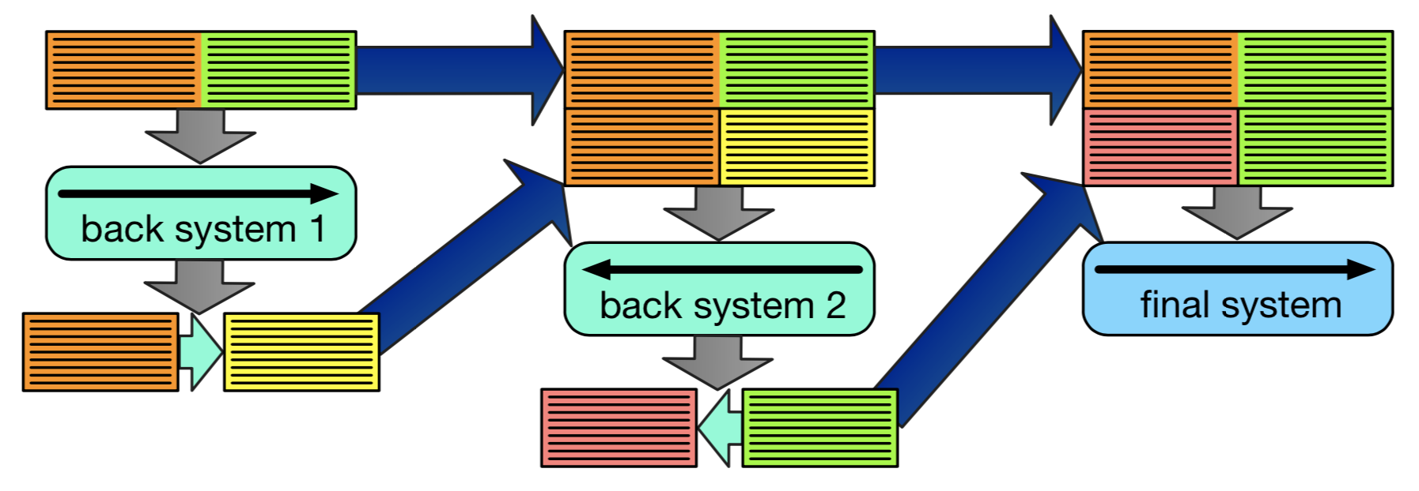
Back-translation++
Iterative back-translation as ‘co-training’
Beat SOTA on ‘big’ data track WMT by 1+BLEU
Works also for PBMT(Moses)
알 수 없음
http://www.statmt.org/moses/index.php?n=Main.HomePage

Slide 40
Understanding Back-Translation
Sampling better than greedy/beam inference for back-translation
MAP solution doesn’t model true distribute on well
Compromise between MAP and unrestricted sampling: sample from top-k of beam
Adding noise to input sentence(target) prior to back-translation
알 수 없음
https://aclweb.org/anthology/D18-1045

Slide 41
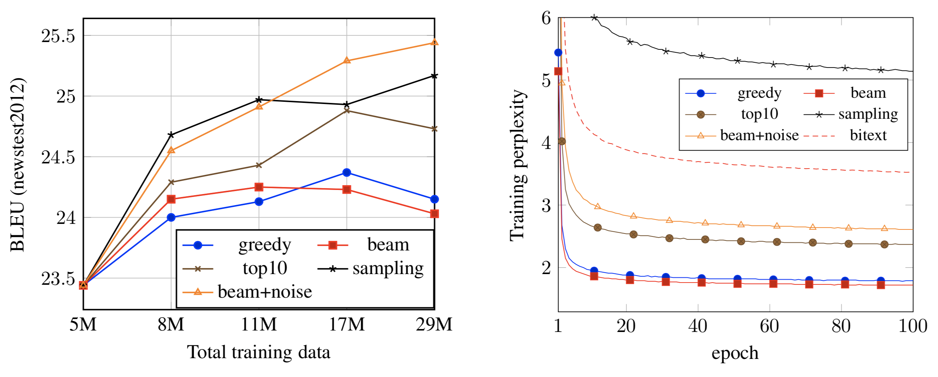
Understanding Back-Translation
알 수 없음
Notes:
Perplexity: 혼란, 당혹

Slide 42
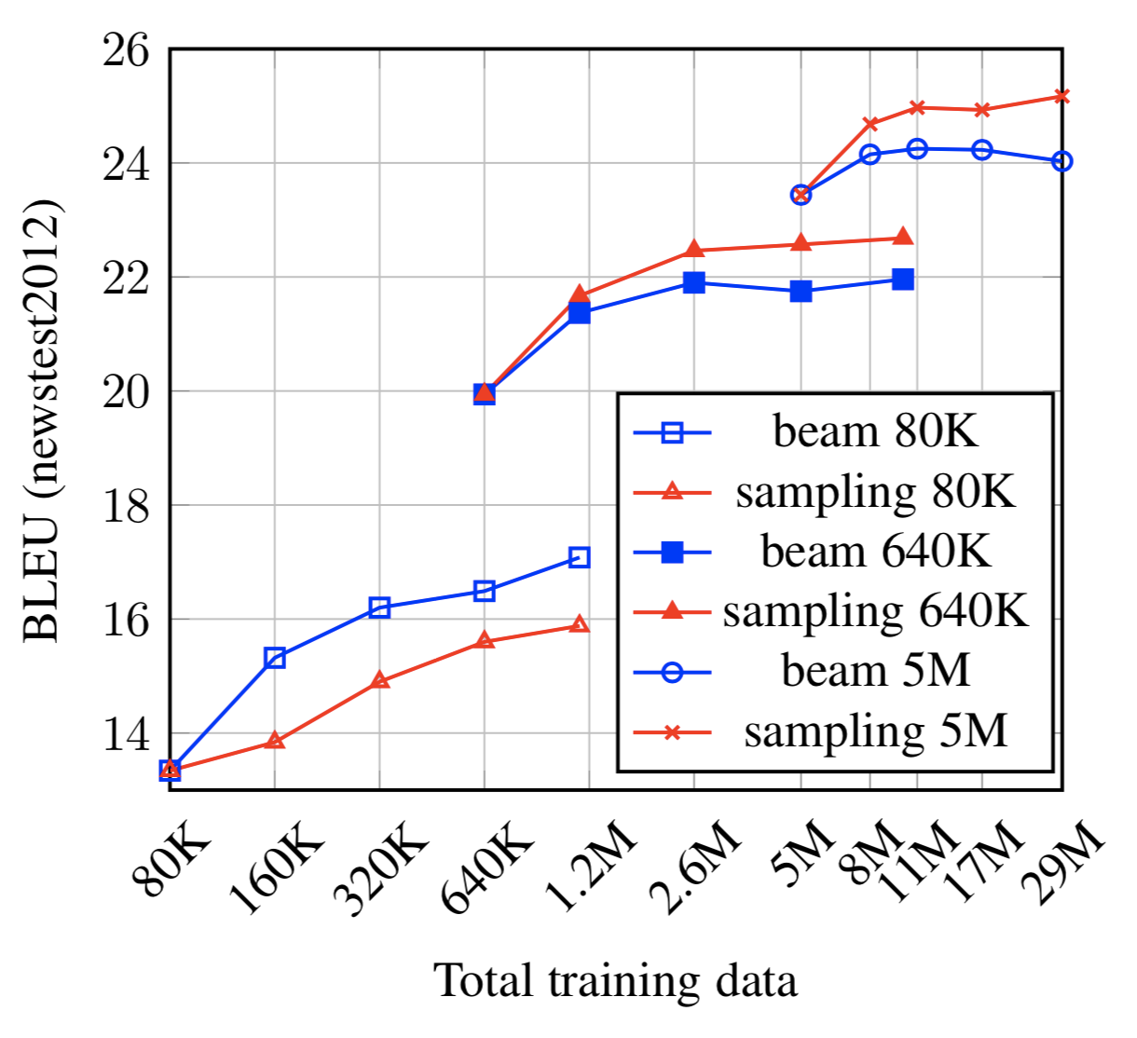
Understanding Back-Translation
MAP data is too predictable
Sampled data sometimes poor quality
Diversity more important than accuracy unless in low-resource setting
Up-sampling real data helps MAP methods
알 수 없음

Slide 43
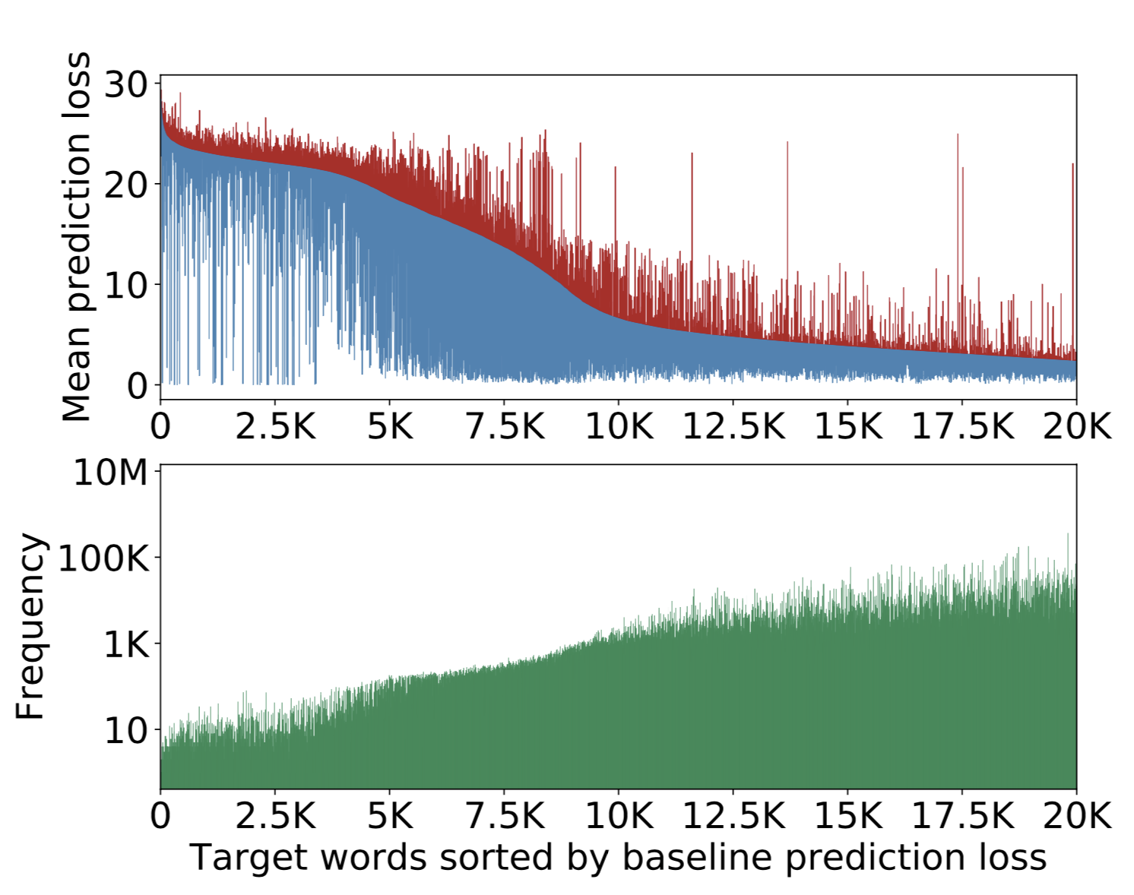
Back-Translation for Difficult Words
Re-training on syntactic data redistributes loss more evenly
So focus on rare/hard words
Use mean prediction loss
Best results sampled difficult words based on contexts close in embedding space
알 수 없음

Slide 44
How can we build NMT systems for language pairs with very little parallel data?

Slide 45
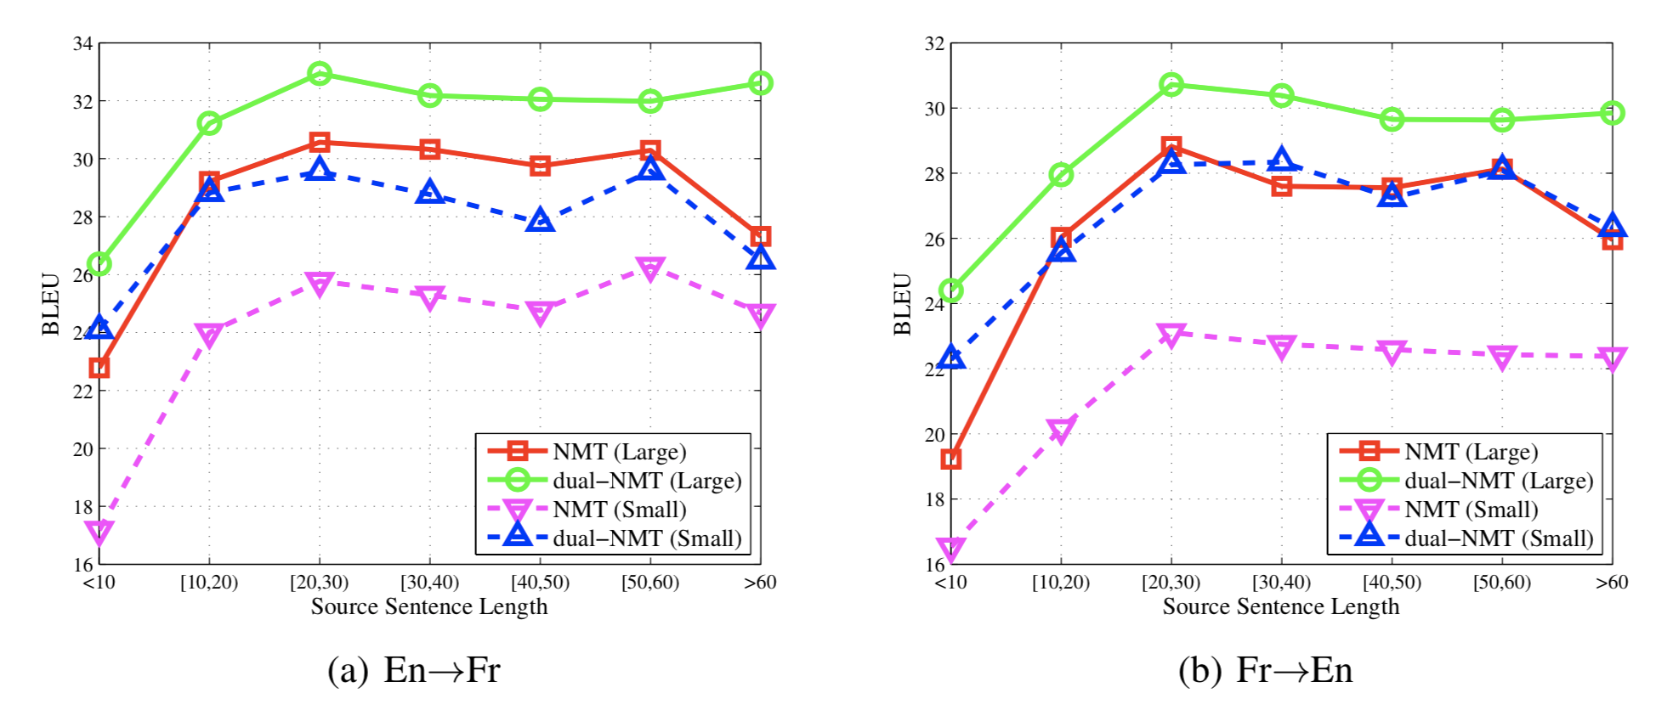
Dual Learning
Translate from A to B with TM(B|A)
Reward = LM(B) + TM(A|B) (i.e. language model + reconstruction cost)
Optimize with policy gradient
https://papers.nips.cc/paper/6469-dual-learning-for-machine-translation.pdf

Slide 46
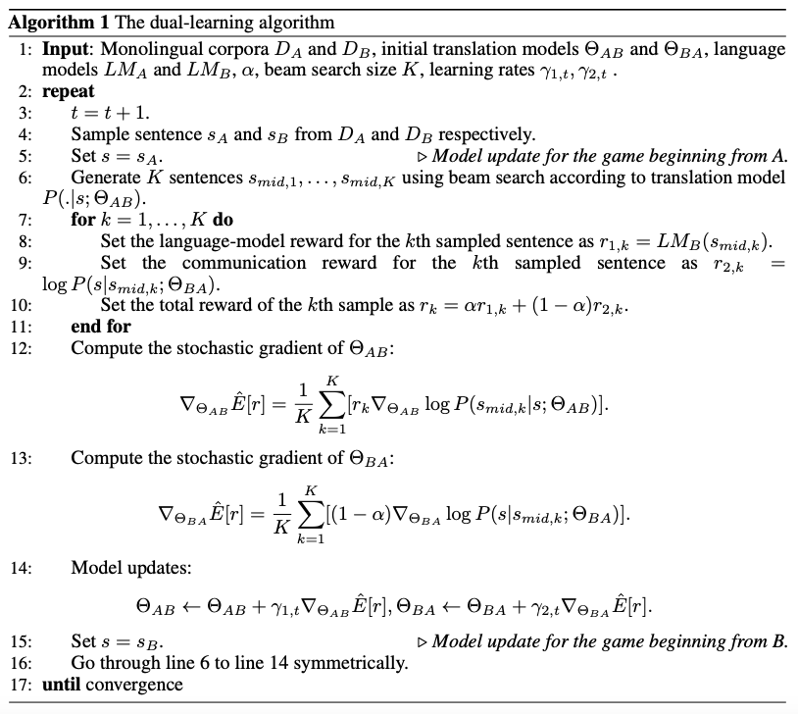

Slide 47
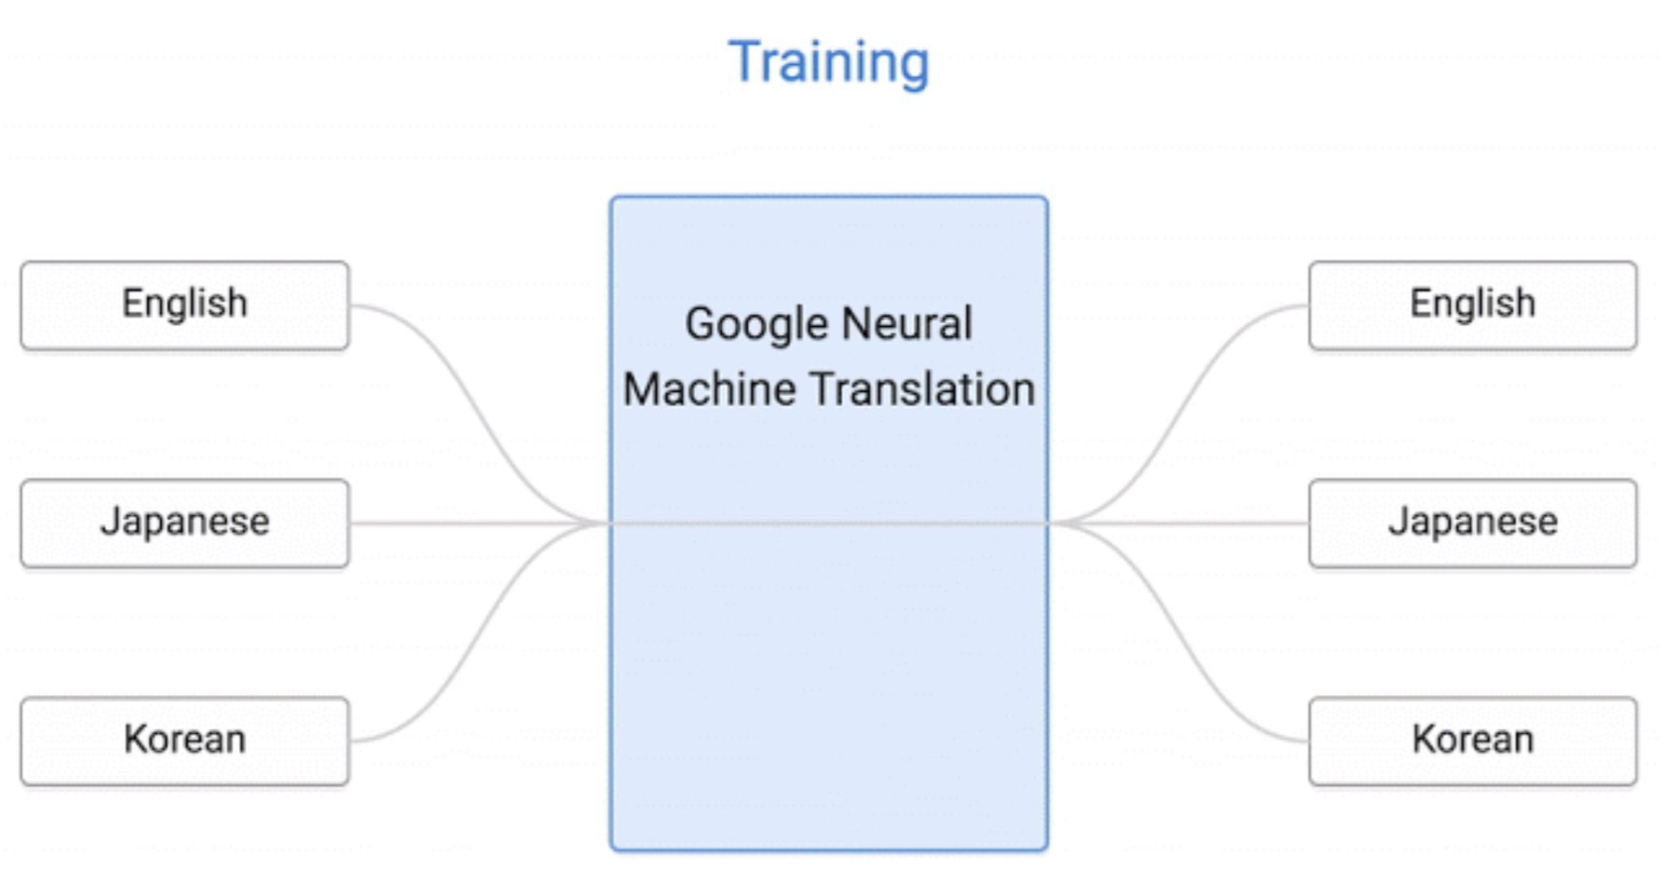
Zero Shot
https://nlp.stanford.edu/~socherr/SocherGanjooManningNg_NIPS2013.pdf
https://arxiv.org/pdf/1611.04558.pdf
http://m.zdnet.co.kr/news_view.asp?article_id=20170302163740#imadnews

Slide 48
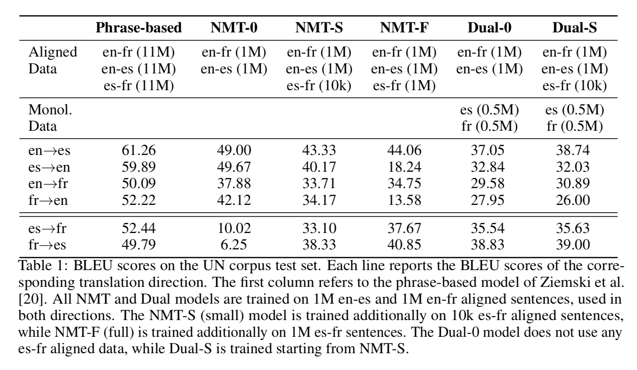
Zero Shot Dual Learning
Start with zero-shot then improve with dual learning
Within 2 BLEU of NMT trained on 1M sentences
알 수 없음

Slide 49
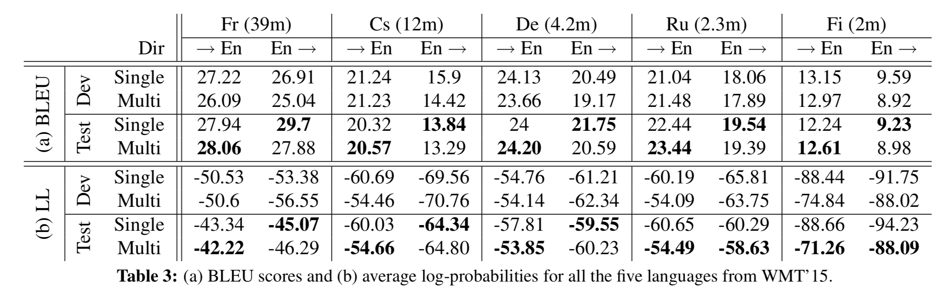
Shared Attention
One encoder and one decoder per language: O(L) rather than O(L^2)
Language independent attention aids transfer learning also
Add mappings to and from attention state
Shared attention always better in low-resource setting
알 수 없음
https://arxiv.org/pdf/1601.01073.pdf

Slide 50
Contextual Parameter Generator
Given S source languages and T target languages
Pairwise: standard NMT O(ST)
Per-language: shared attention O(S+T)
Universal O(1)
Claims:
Universal has high sample complexity(under-parameterized)
Pairwise and per-language encoder/decoder are over-parameterized
Embedding ‘language’ in same space as words is unintuitive
https://arxiv.org/pdf/1808.08493.pdf

Slide 51
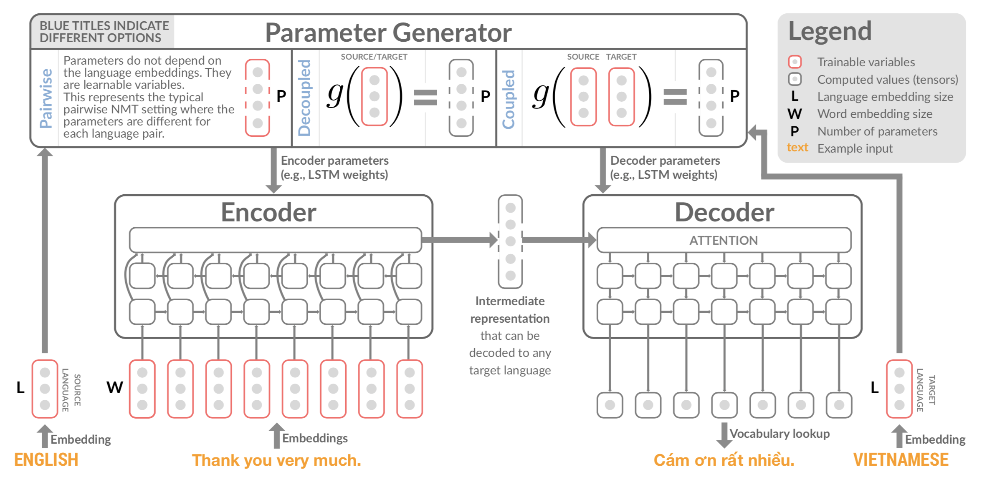
Contextual Parameter Generator

Slide 52
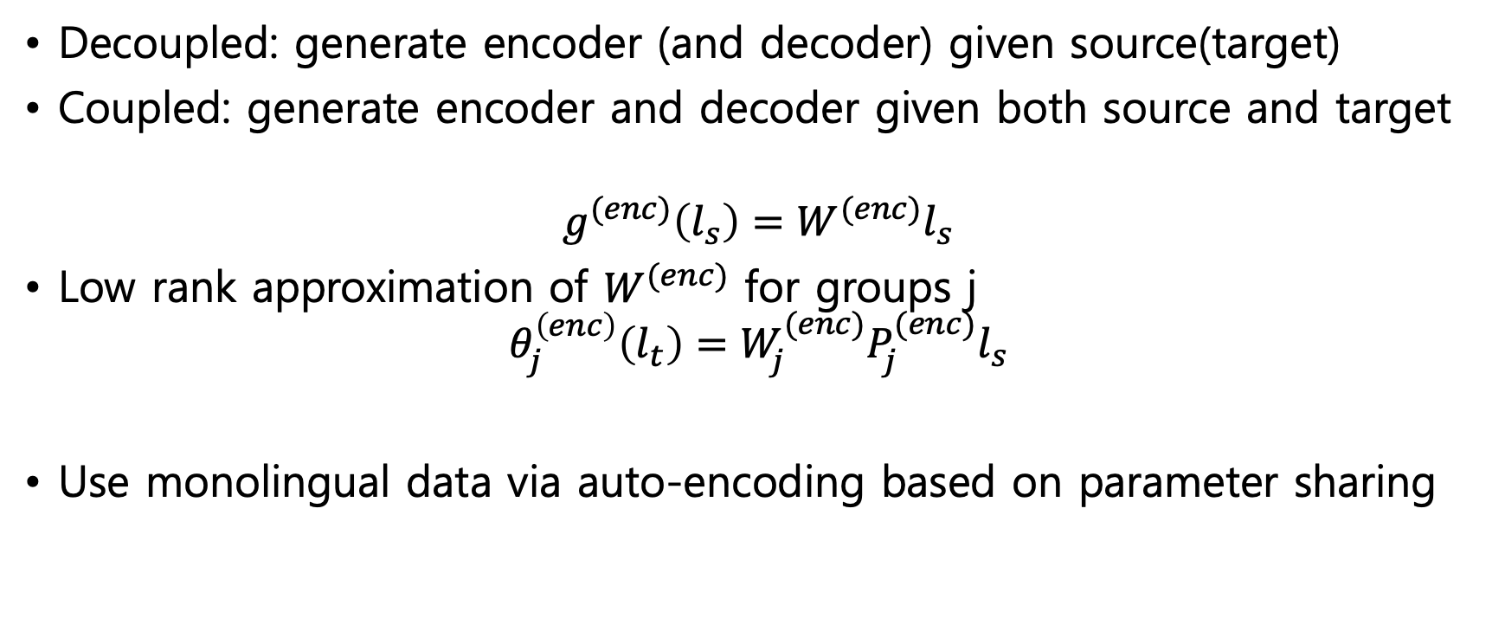
Contextual Parameter Generator
Decoupled: generate encoder (and decoder) given source(target)
Coupled: generate encoder and decoder given both source and target
$$g^{(enc)}\left(l_{s}\right)=W^{(enc)}l_{s}$$
Low rank approximation of $W^{(enc)}$ for groups j
$$θ_{j}^{\left(enc\right)}\left(l_{t}\right)=W_{j}^{(enc)}P_{j}^{(enc)}l_{s}$$
Use monolingual data via auto-encoding based on parameter sharing

Slide 53
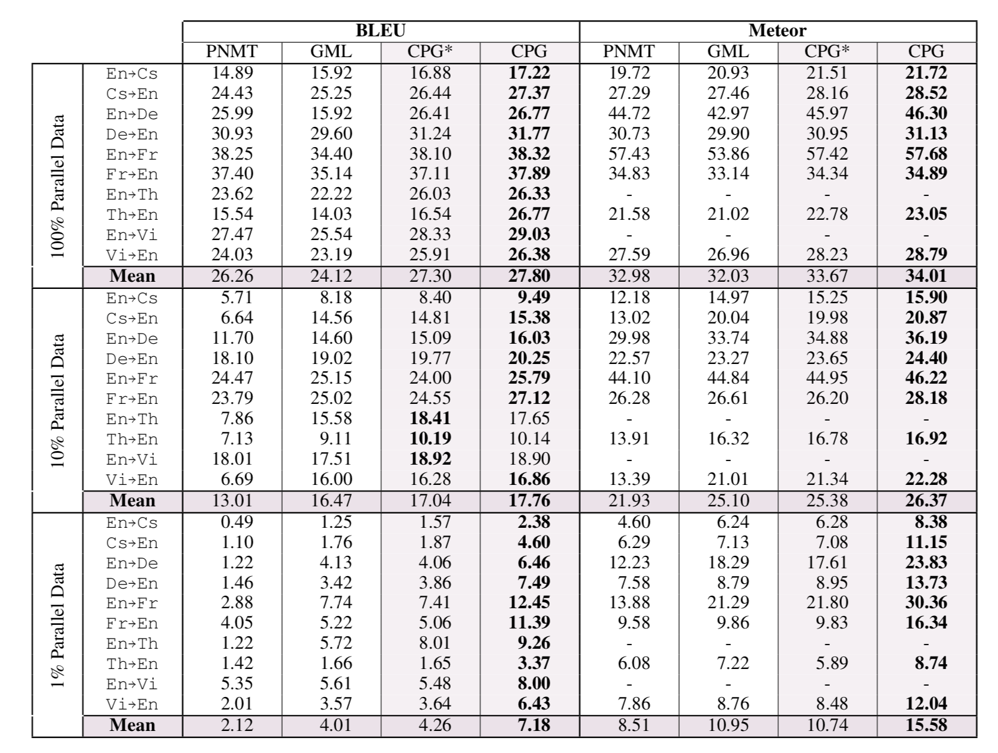
Contextual Parameter Generator
알 수 없음

Slide 54
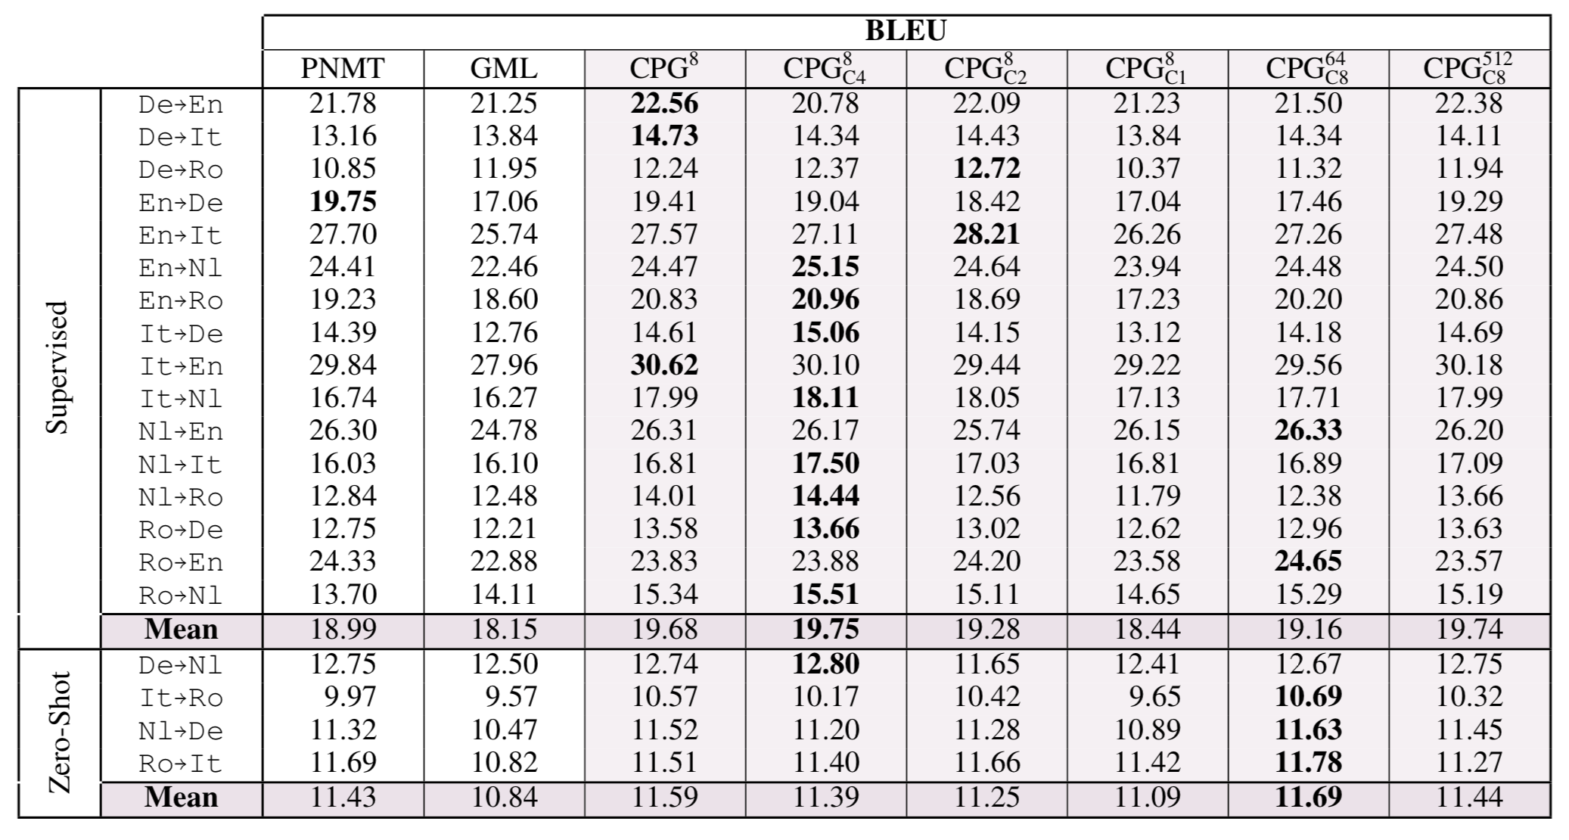
Contextual Parameter Generator
알 수 없음

Slide 55
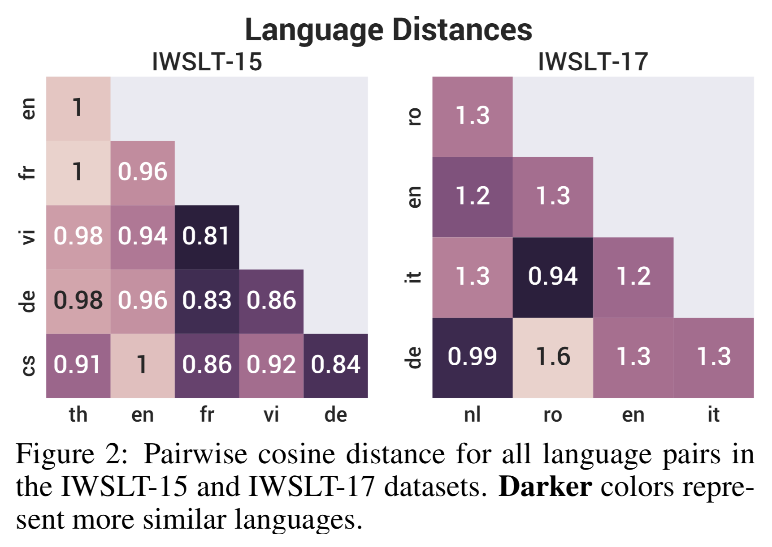
Contextual Parameter Generator
알 수 없음

Slide 56
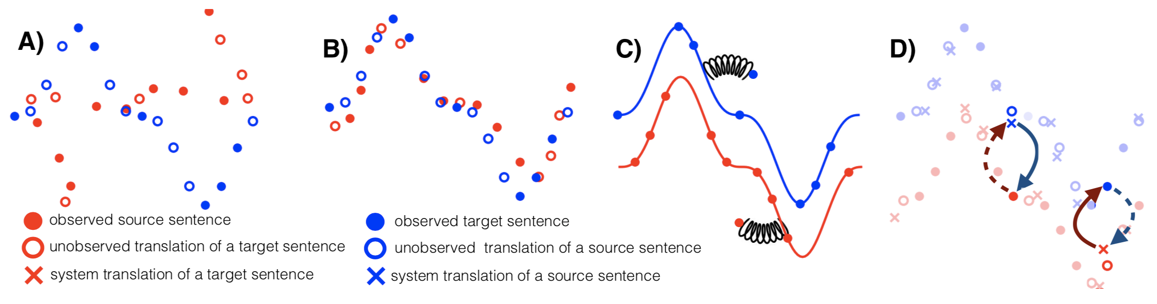
Unsupervised NMT and PBMT
Monolingual corpora
Initialization of translation model (joint BPE, aligned embeddings?)
Language modelling to ‘de-noise’ weak translations
Iterative back-translation
https://arxiv.org/pdf/1804.07755.pdf
Notes:
phrase-based MT

Slide 57
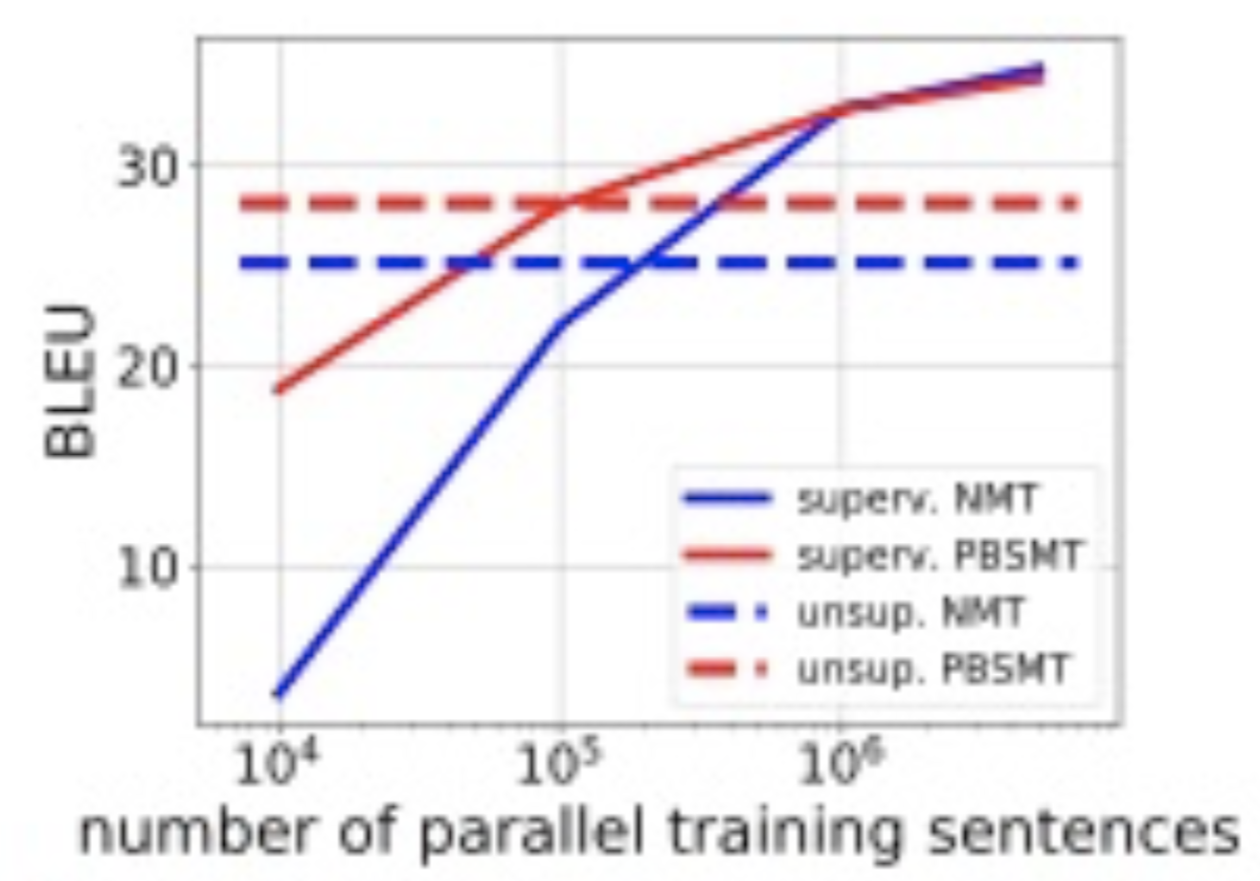
Unsupervised NMT and PBMT
Roundtrip de-noising auto-encoders
Ignore discrete sampling steps in back-prop (i.e. no RL)
Shared encoder parameters
Phrase table built from frequent monolingual phrases scored by word embedding model
PBMT not bad at all on lower source
Hybrid PBMT+NMT is best

Slide 58
Has NMT really bridged the gap between MT and human translation?

Slide 59
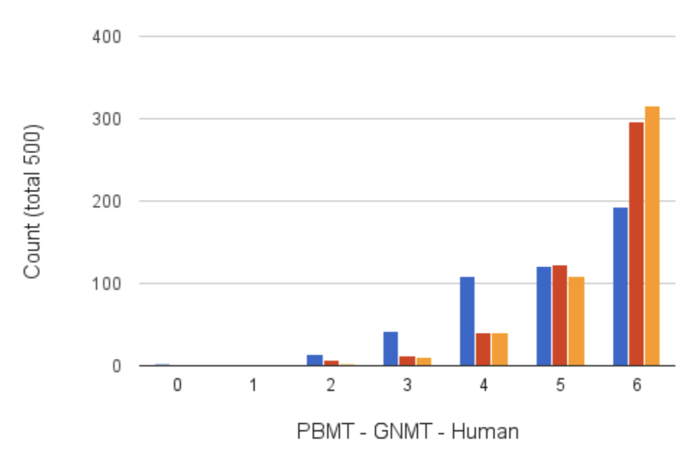
Claims of ‘Human Parity’
What problems are there with this evaluation?
How could we improve it?

Slide 60
Challenges for NMT
Sensitive to domain mismatch
Slower initial learning curve
BPE(byte-pair encoding) helps on rare words but not on rare inflected words (verbs?)
Worse on very long sentences
Attention is not word alignment(?)
Increasing beam doesn’t help (short hypotheses end up winning too often even with length normalization)
http://opennmt.net/OpenNMT/translation/beam_search/
http://www.aclweb.org/anthology/W17-3204

Slide 61
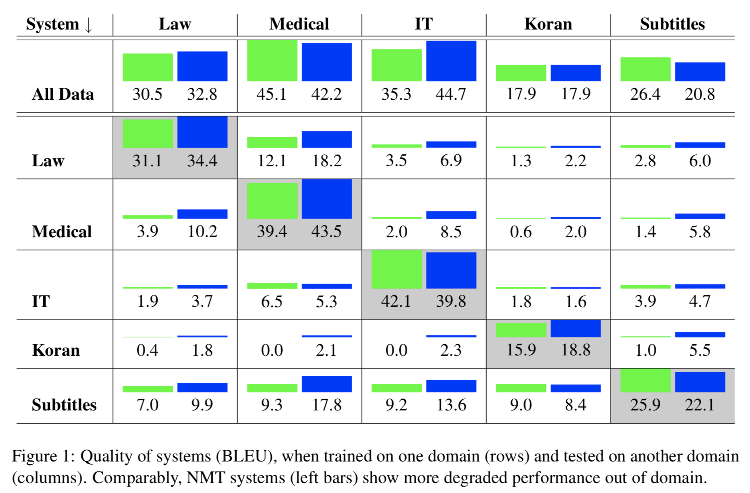
Challenges for NMT
알 수 없음

Slide 62
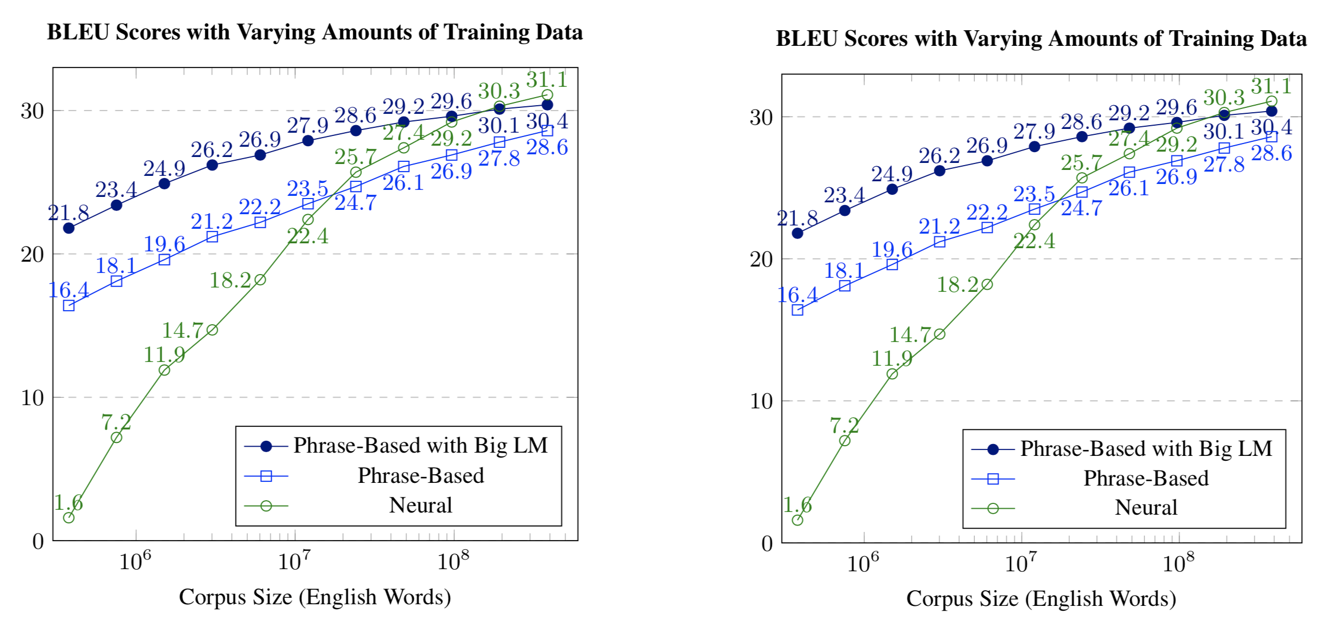
Challenges for NMT

Slide 63
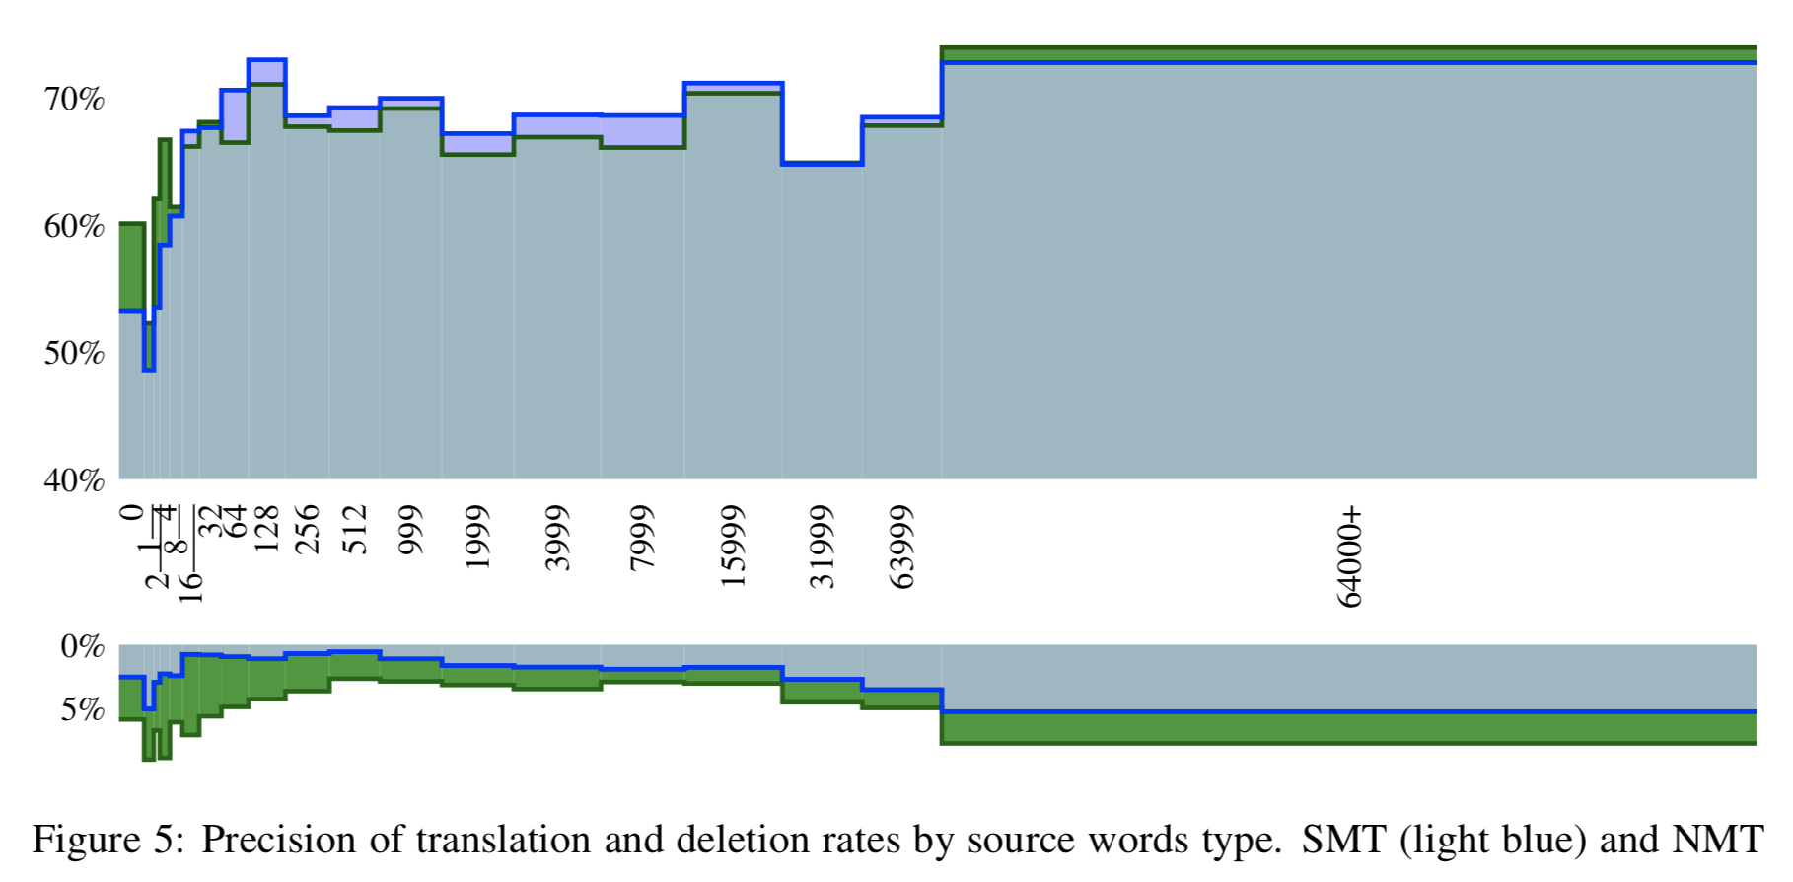
Challenges for NMT
NMT translates words seen once worse than OOVs
PBMT slightly worse performance on rare words
알 수 없음

Slide 64
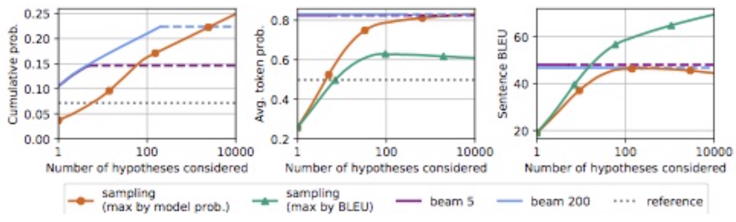
Analyzing Uncertainty
Beam is efficient but only covers 25% of probability
BLEU imperfectly correlated with model probability
Copies over represented in the beam–hence large beams are bad
알 수 없음

Slide 65
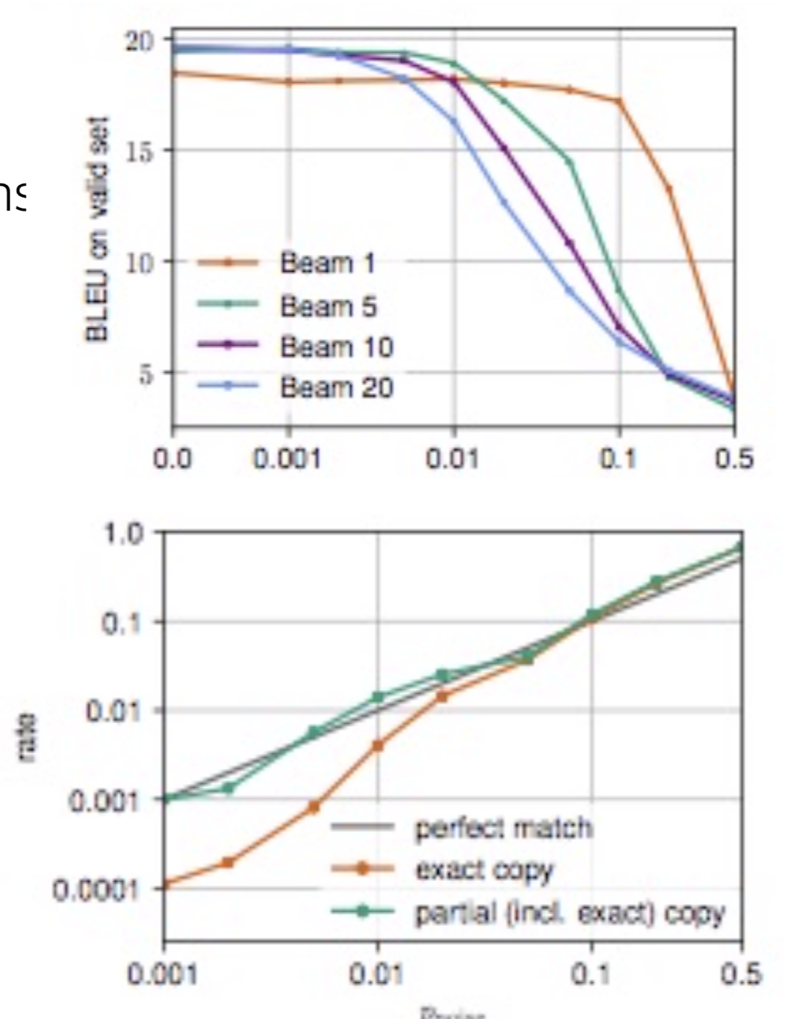
Analyzing Uncertainty
Beam explores only high probability tokens
Noise in training data has more impact on larger beams
Rare words not matched by beam search
Control: add copies as noise
Conclusion: model is too smooth: it assigns mass to unobserved partial copies
알 수 없음

Slide 66
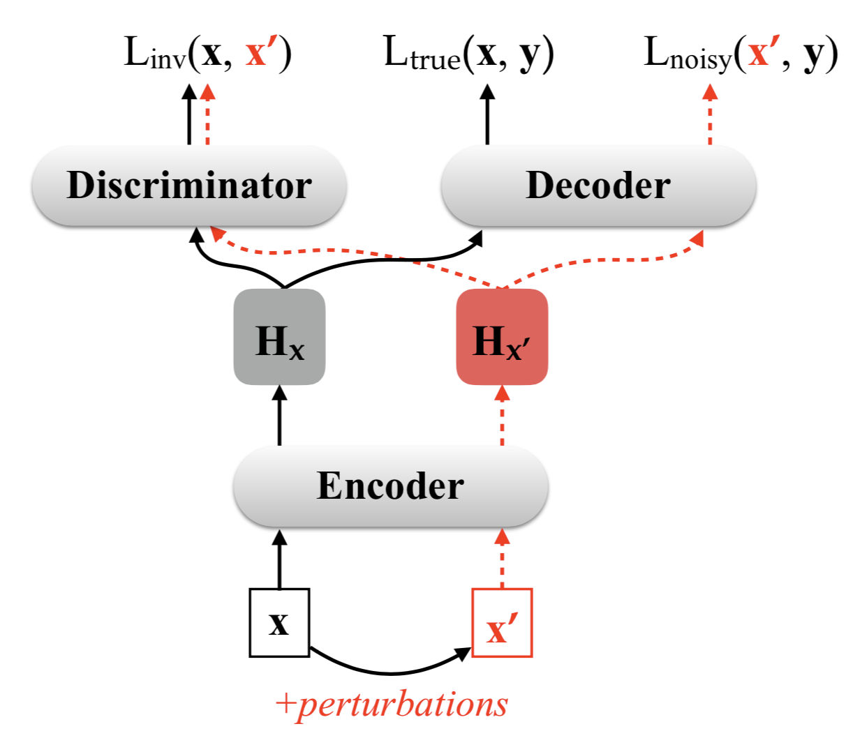
Perturbation-Invariant Encoder
Crazy translations are common
NMT is sensitive to noise in input
Adversarial stability training: train noise-invariant encoder and decoder
Discriminator tries to distinguish noised from real data
Noise types: lexical(words) vs. feature (embeddings)
Feature noise works best on clean test
Ablation study
알 수 없음
http://aclweb.org/anthology/P18-1163

Slide 67
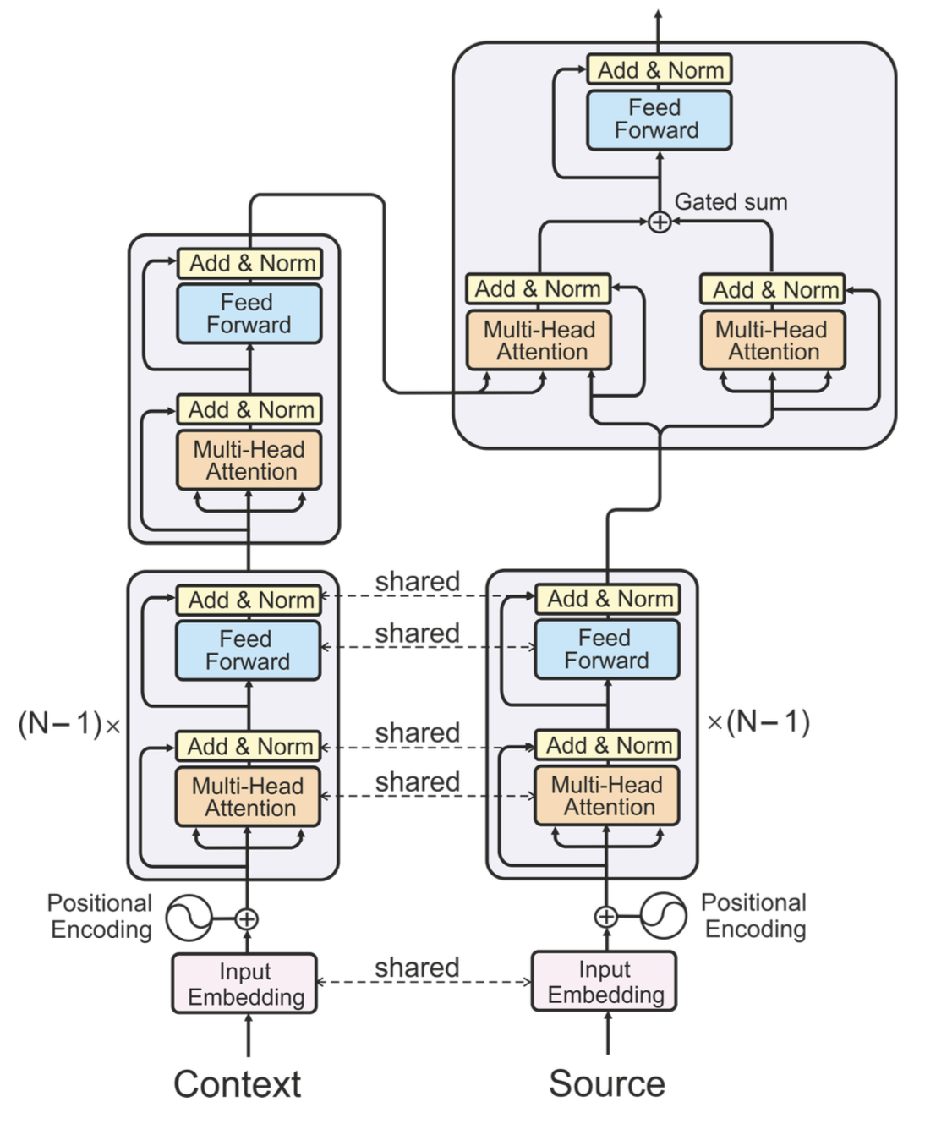

Context Aware
알 수 없음
http://aclweb.org/anthology/P18-1117

Slide 68


Context Aware
Choice of baselines
Interpretable architecture
알 수 없음

